Slide 1
Module 10: Implementing Adaptive Grazing Management
Don’t halfway manage
Analogy to Mechanic
Do you want your grass to just exist or perform like a race car?
Basic Grazing Management
  Maintain leaf area and stem carbohydrate reserves
  Graze a paddock for 3 days or less
  Recovery time 14 to 210 days
  Longer grazing periods require longer recovery times
  Keep light to desired species
  No bare ground
  Maintain leaf canopy
  Maintain residue cover
  Tromp excess forage and weeds intact with the soil
  Have paddocks in various states of recovery all year

Slide 2
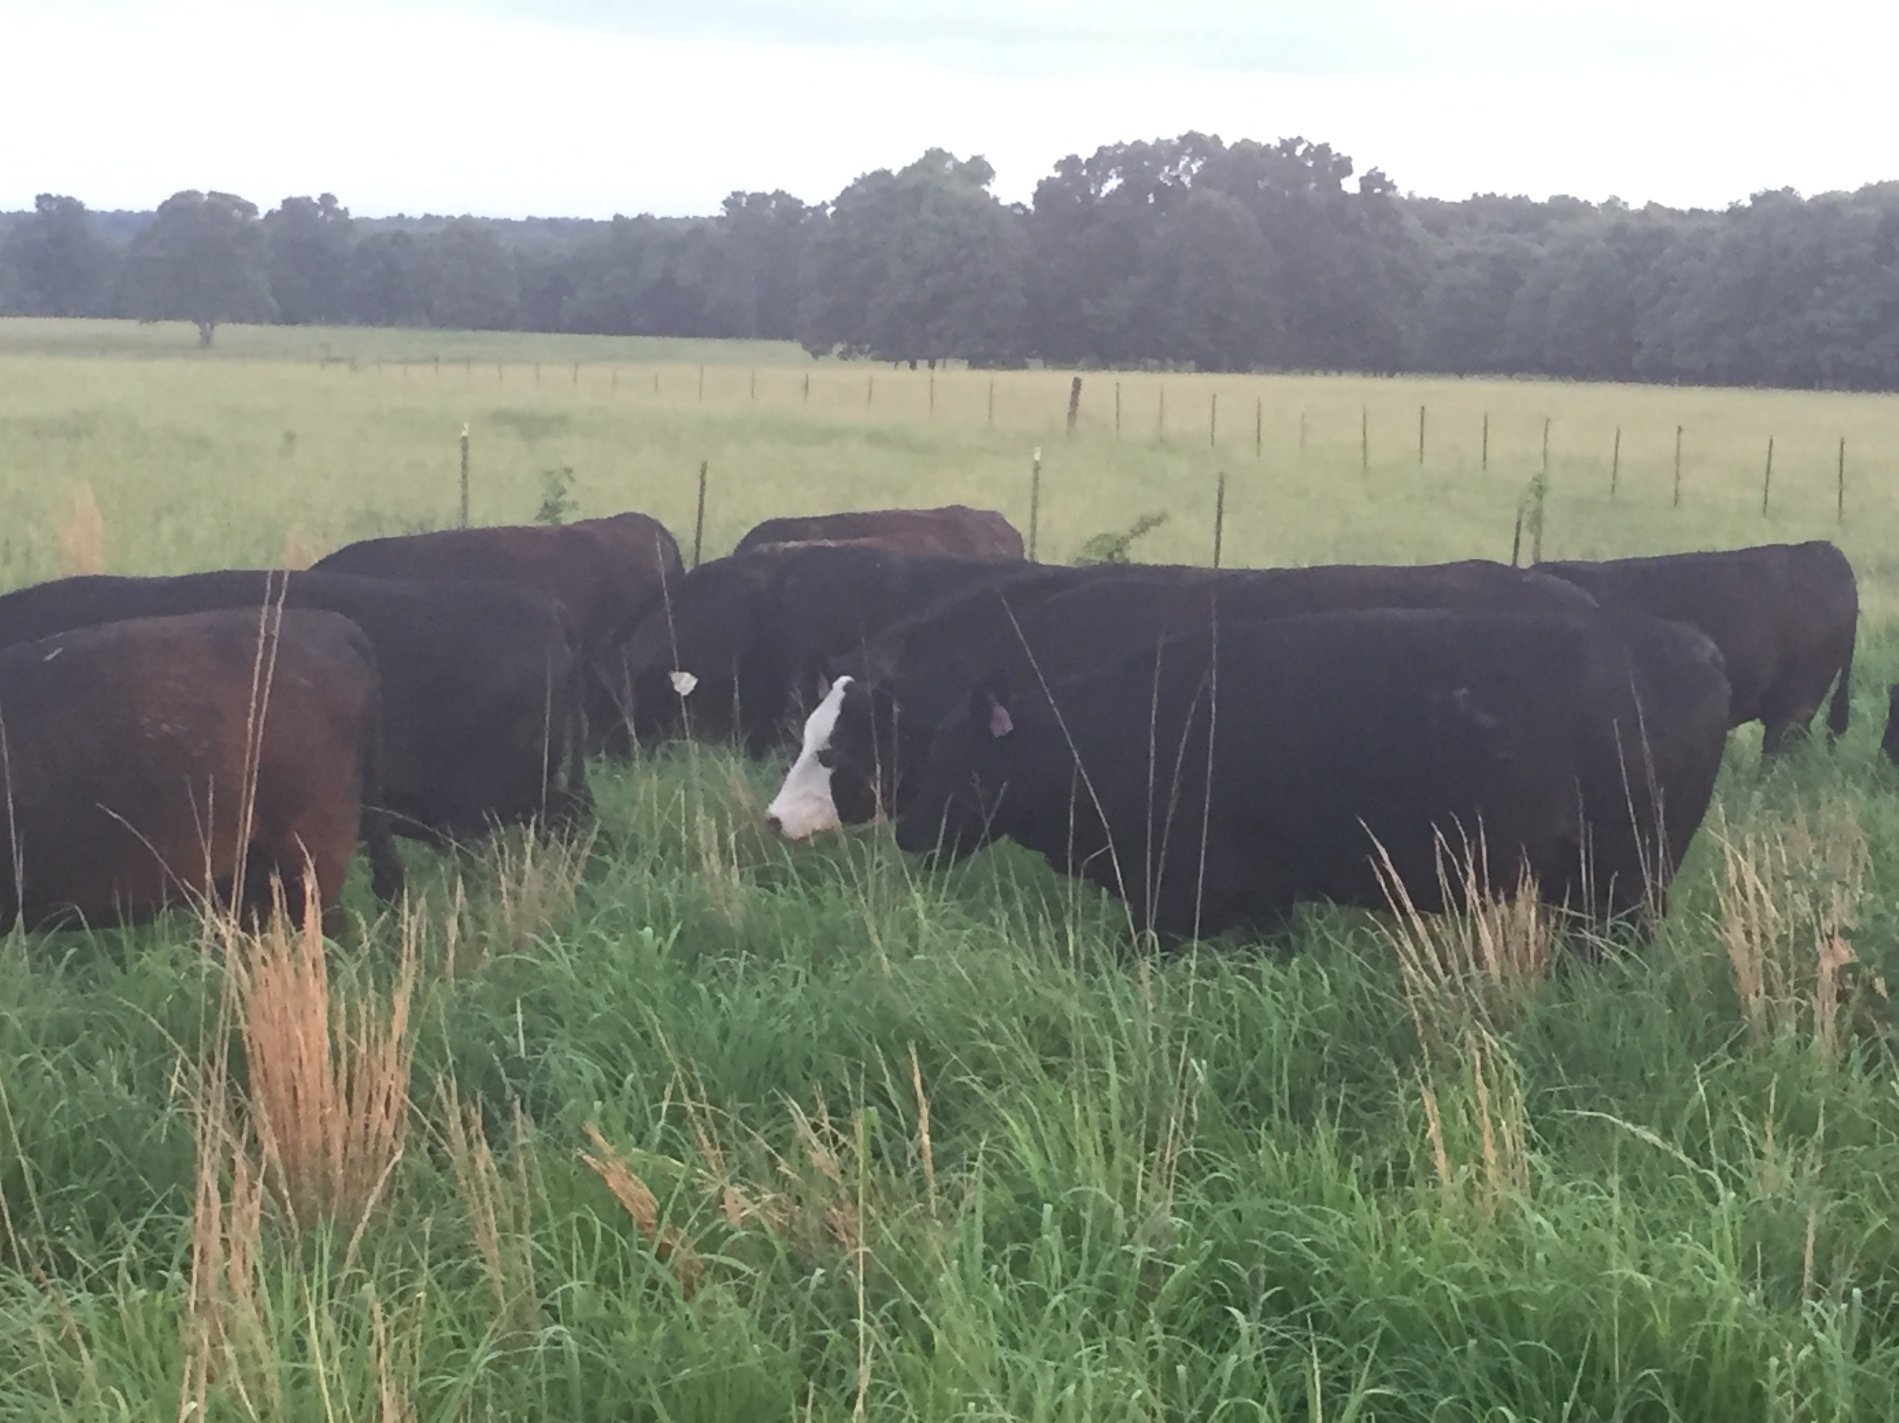

Summary
Grazing for Soil Health and
Production

Slide 3
Objectives
Graze pasture in a manor that encourages increased biological activity.
Increase the resilience and sustainability of grazing land.
Increase forage production.
Reduce the need to mitigate situations. Reduce inputs and increase profitability.

Slide 4
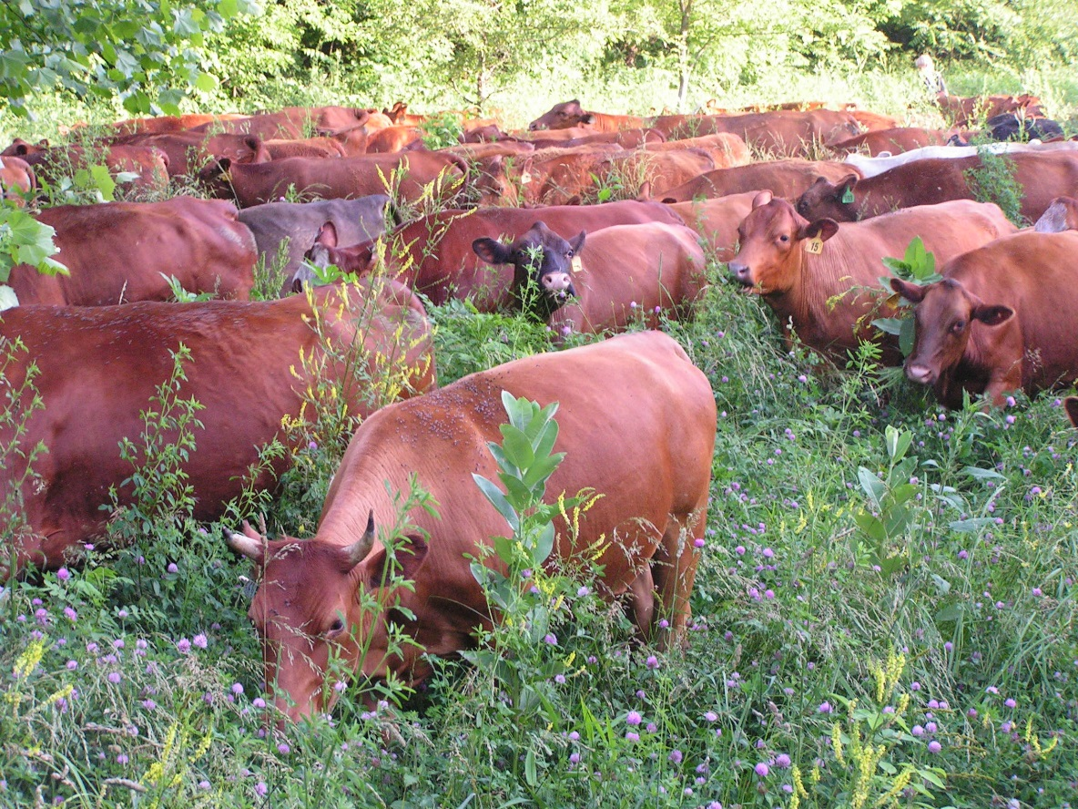
Producers Goal
(Written down)
Quality of Life
Landuse
Vision

Slide 5
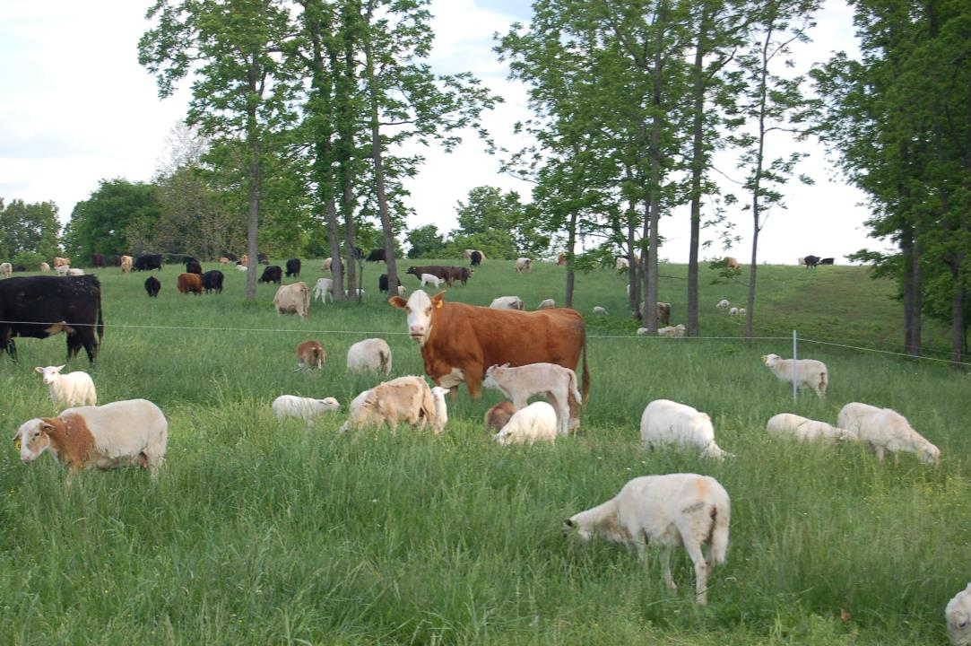
Example: Goal for my farm-”A healthy, low stress, low cost, grazing operation that is productive, improves the environment and life while being consistently profitable.”

Slide 6
Summary
Have a Plan!
Plan ahead- think about where you will calve and where you will wean well in advance so you can prepare!

Slide 7
Summary (7)
Be Flexible
Plans seldom work out!
Livestock will follow you anywhere, don’t be afraid to lead them.

Slide 8
Adaptive Grazing Management
  Uses feedback from system to adapt management to fit ecosystem
  Flexible
  Not a specific grazing system
  Realizes benefits of hands-on management:
    Livestock comfortable with humans (better herd health)
    Power of observance – see changes as they happen
    Minimizes risk associated with unforeseen changes
Feedback Loop
Plan
(Assume Wrong)
Monitor
Control
Replan
Notes:
In addition to the above, the feedback loop diagram emphasizes that planning is a continuous process, not an event. In the first step a plan is created, but because of nature’s complexity, the plan will have to be altered which is why the plan is assumed to be wrong. Then monitoring is done, on the assumption that the plan is incorrect, for the earliest possible warnings so that control measures and replanning can happen before any damage is done.
Holechek, J. L., Pieper, R. D., & Herbel, C. H. 2004. Range management: principles and practices (No. 636.0845 DC21 2004).
Savory, A., Butterfield, J. 2016. Holistic Management: A commonsense revolution to restore our environment, 3rd edition. Island Press. Page 62.

Slide 9
Summary (2)
Be Flexible
Know your Why!
Its ok to do anything once as long as you know why you are doing it!

Slide 10
Management Strategies for
Grazing Grassland
Rotation Based on Pasture Readiness
1
4
5
6
2
5
4
7
2
3
8
7
3
8
1
6
15
16
9
10
15
11
10
16
14
13
12
11
13
12
9
14
Justin Morris, USDA-NRCS
Notes:
Because of variations in how low plants were grazed previously as well as differences in soil type, topography, plant species composition and weather, not all paddocks are going to recover at the same rate or in the same order. That’s why the grazier needs to monitor plant regrowth (step 3 in the feedback loop) and adapt the plan (step 4 in the feedback loop) to only allow livestock to graze paddocks that have fully recovered. Estimating forage biomass for each paddock every two weeks during the growing season and recording it in a spreadsheet can be a very handy way of making sure that all paddocks achieve sufficient recovery before being re-grazed.
Note: numbers in white represent the move number

Slide 11
Summary (3)
Be Flexible
Know your Why!
Keep the soil health principles in your fore-thought!

Slide 12
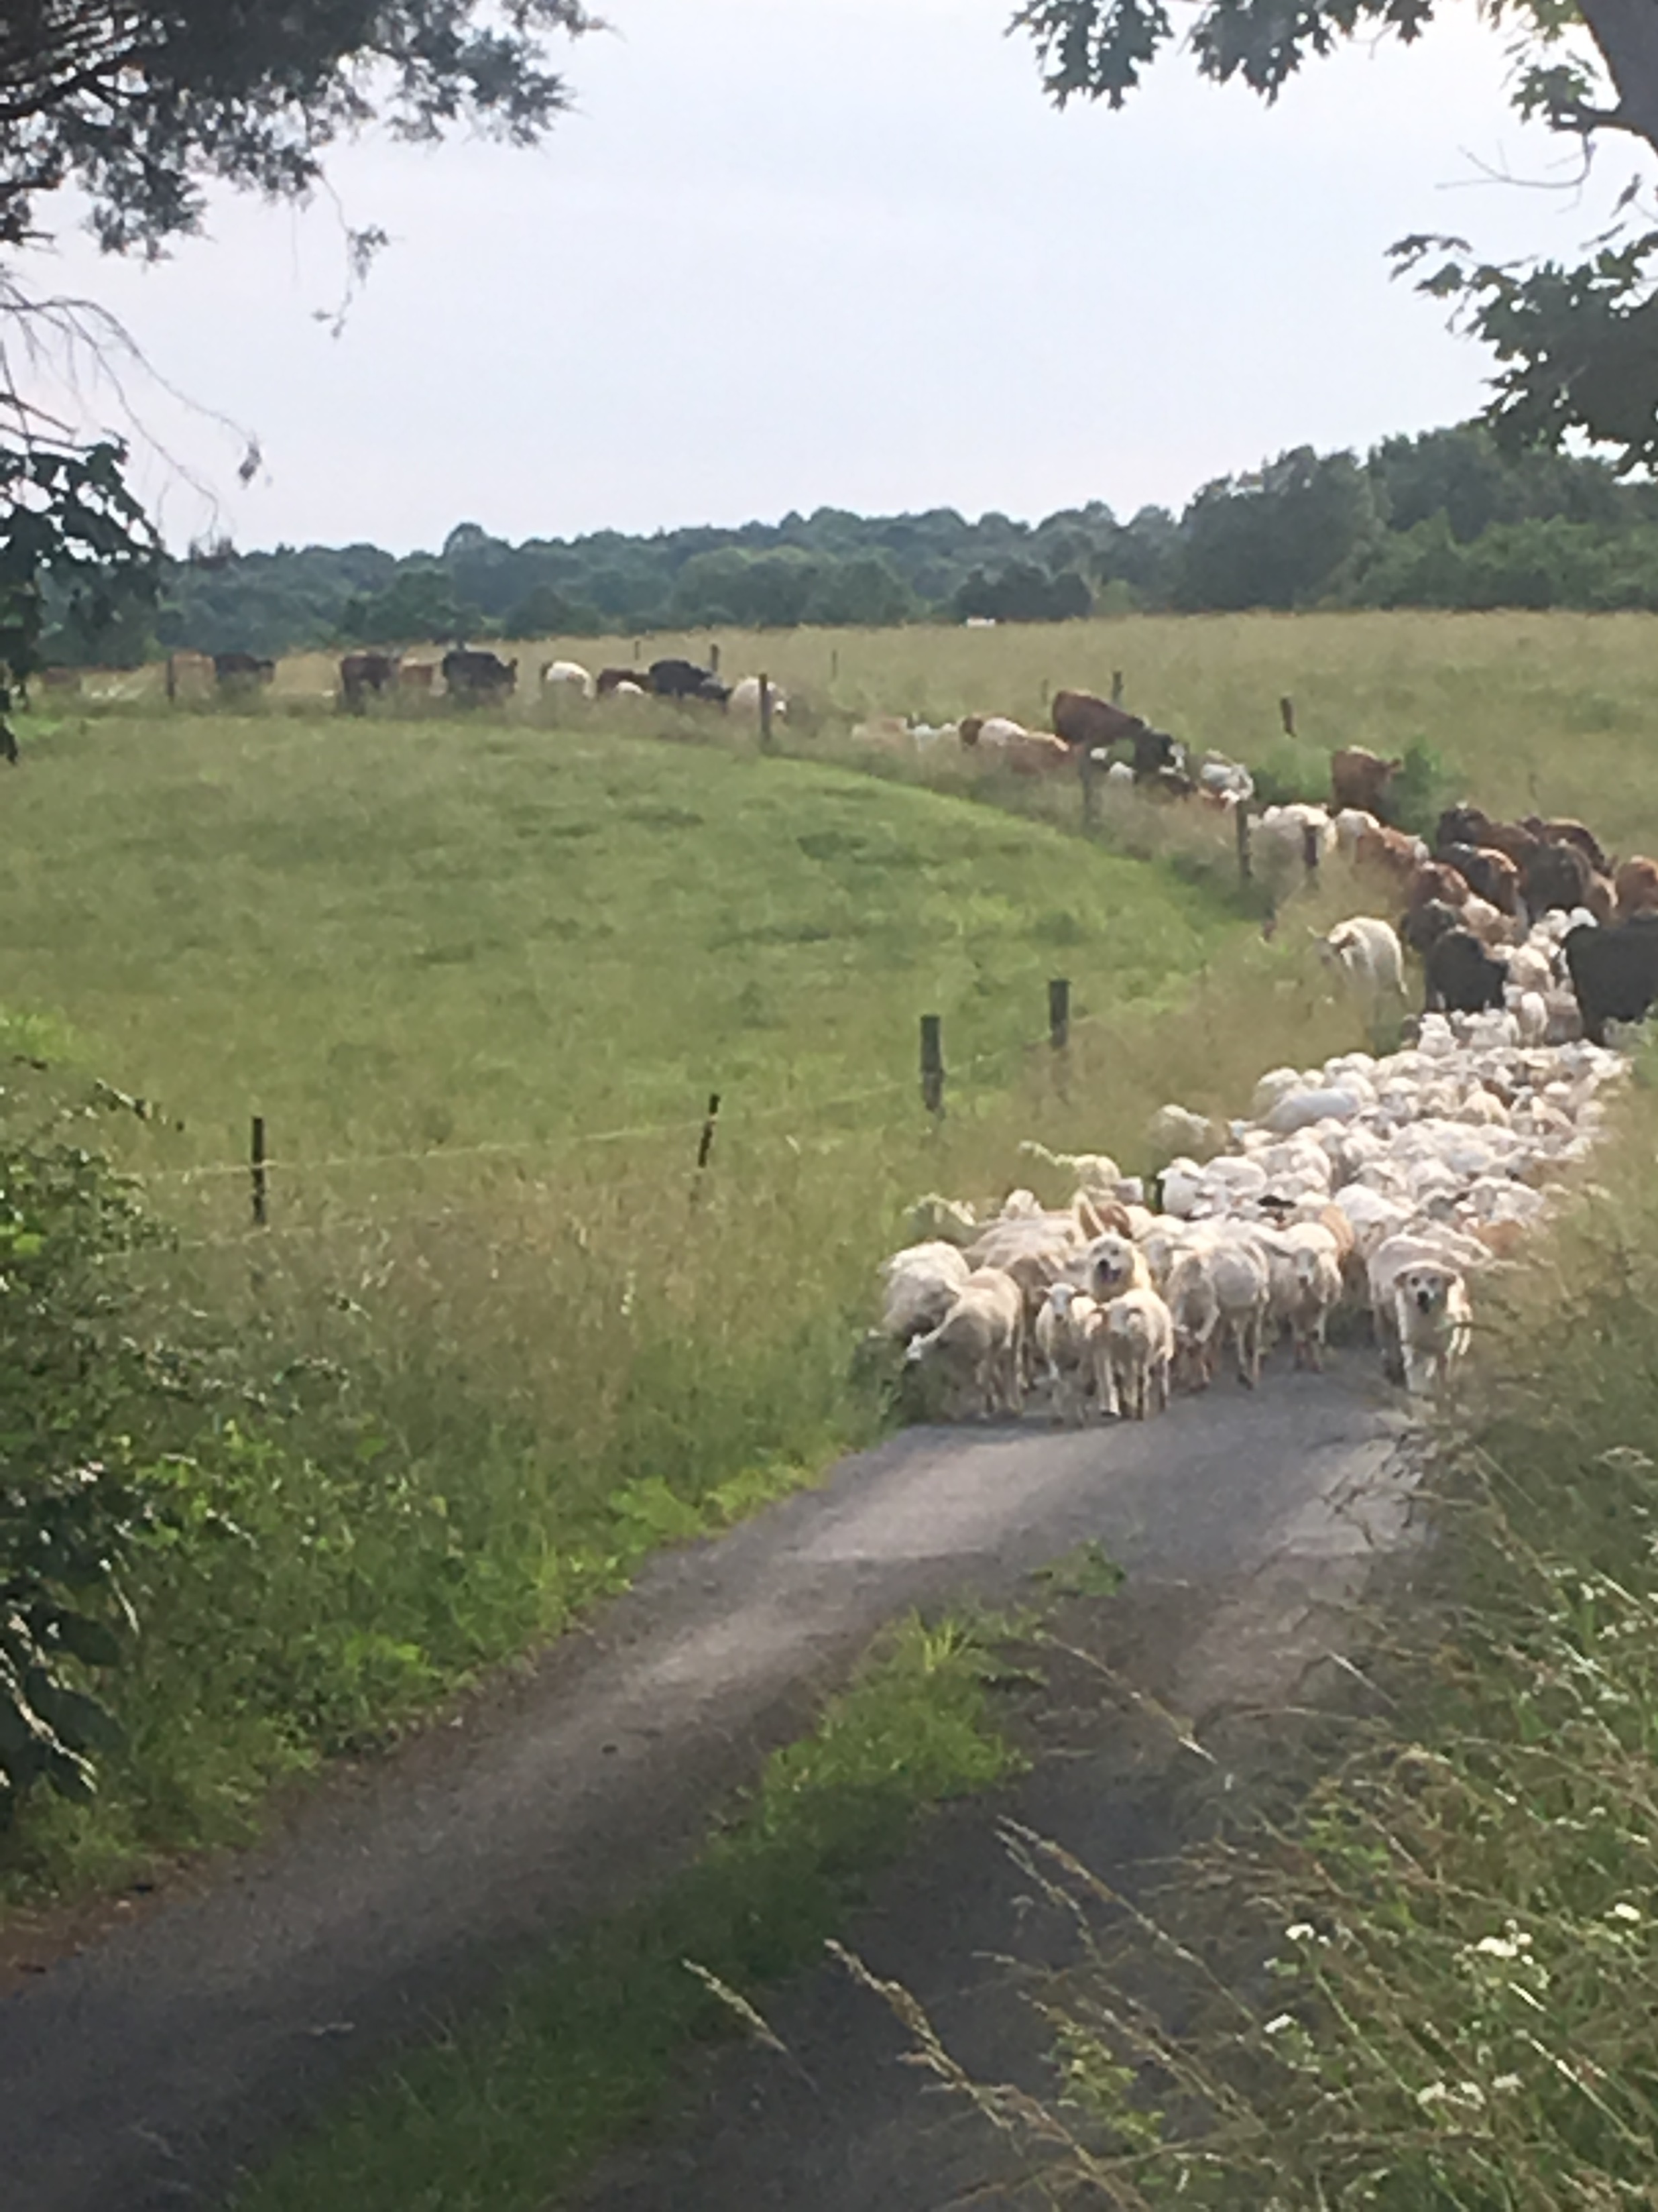
Fundamentals
Balanced Soil fertility
Maintain minimum heights
Continuously feeding the herds above and below ground
Maintain Cover
Living Roots
Diversity
Paddock layout
Water distribution
Ration grass
No bare ground!

Slide 13
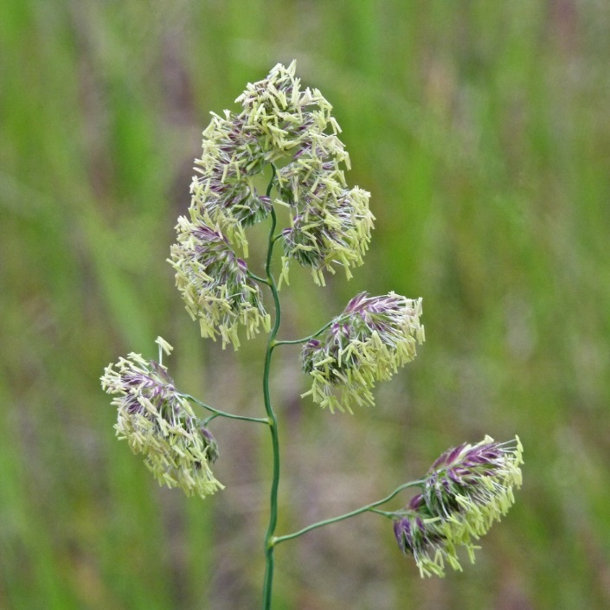
Orchardgrass Cutting Height Study by the University of Kentucky
Ray Smith and Associates
4-year-old field of Benchmark Plus
3 Cutting Heights
  4 inches
  2 inches
  ½ inches
4 Fertilizer Rates (3 applications)
  0 N and 0 K
  60 N and 0 K
  0 N and 100 K
  60 N and 100 K

Slide 14
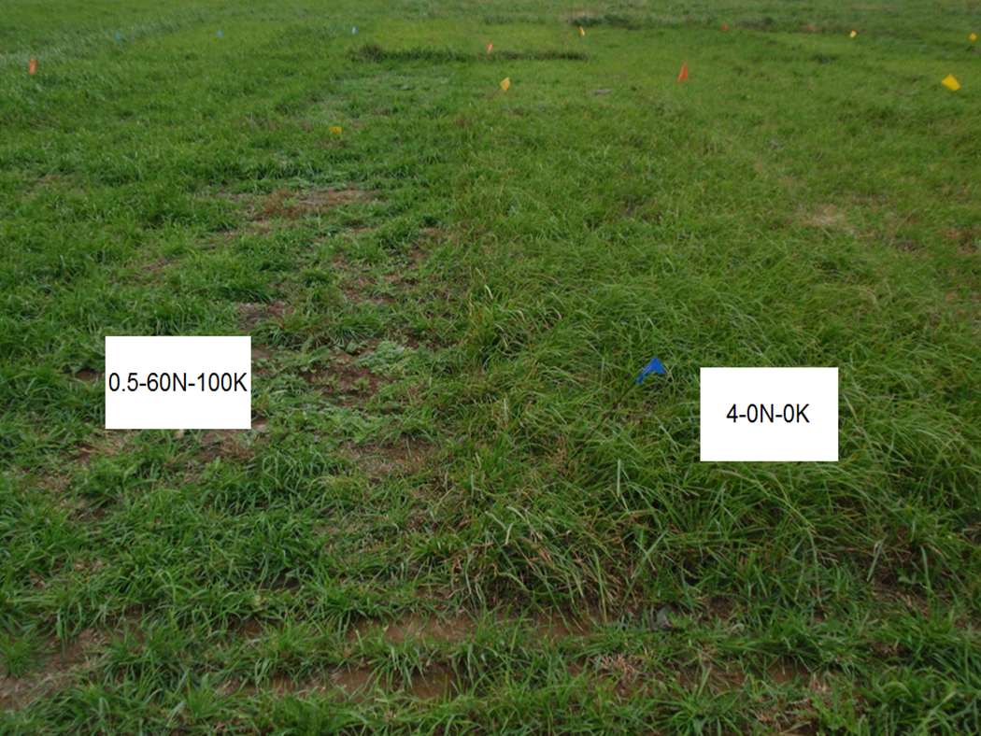

1

Slide 15
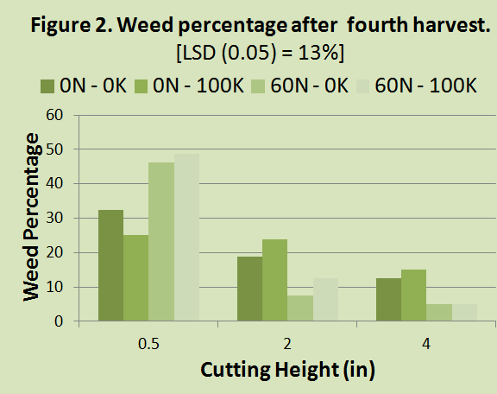
2

Slide 16
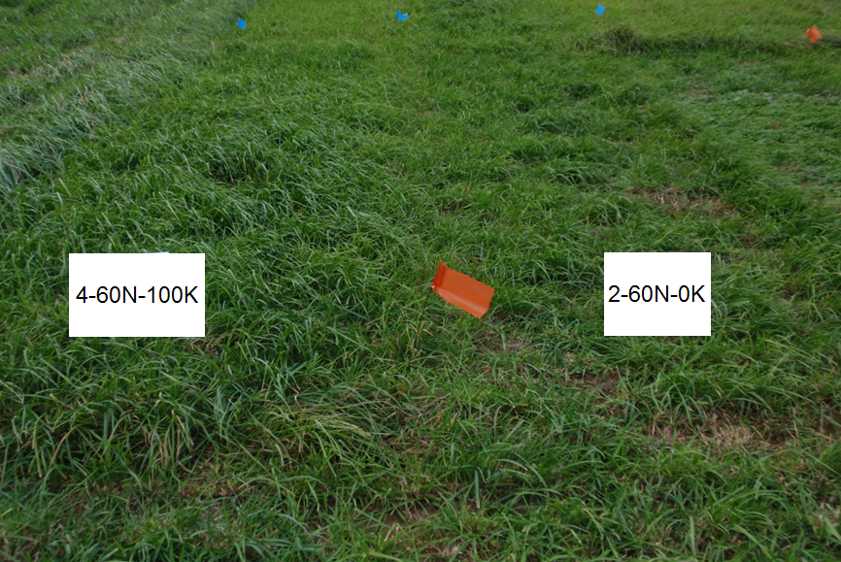

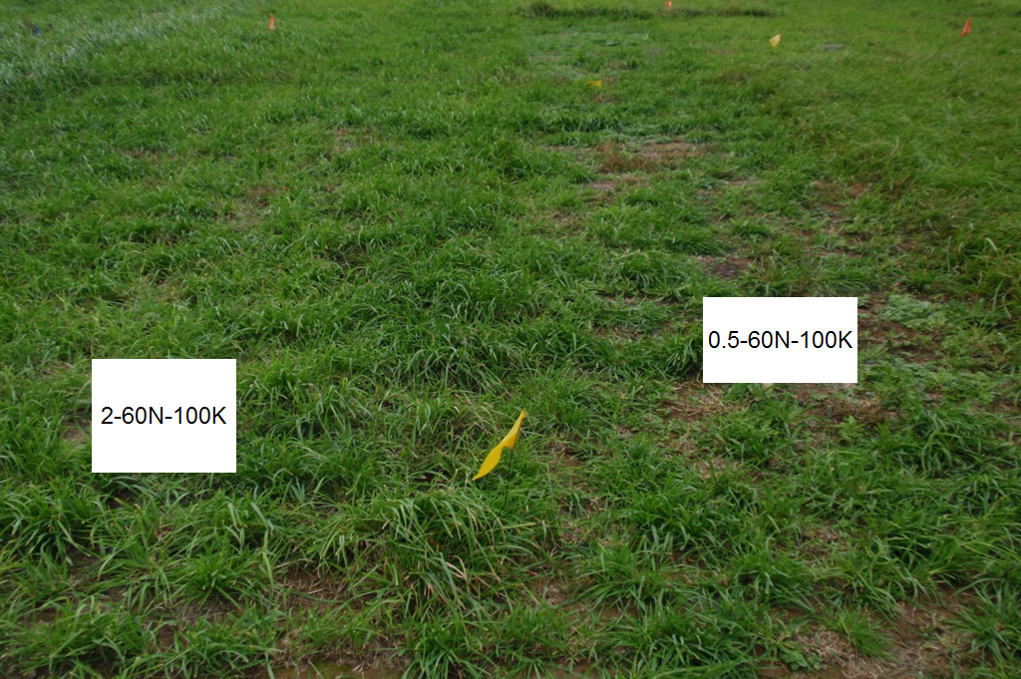
3

Slide 17
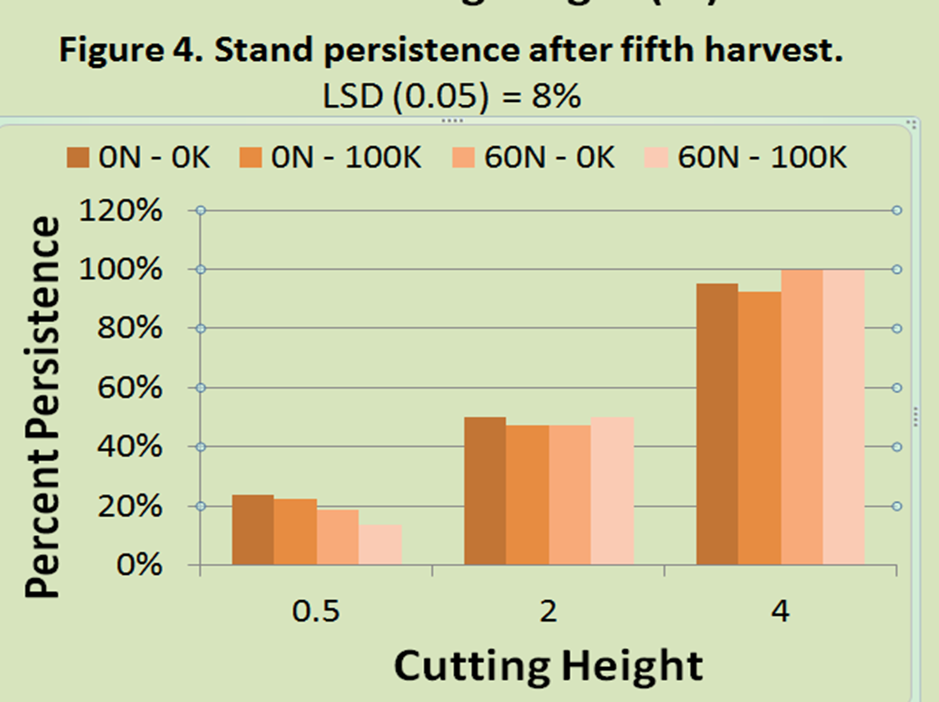
4

Slide 18
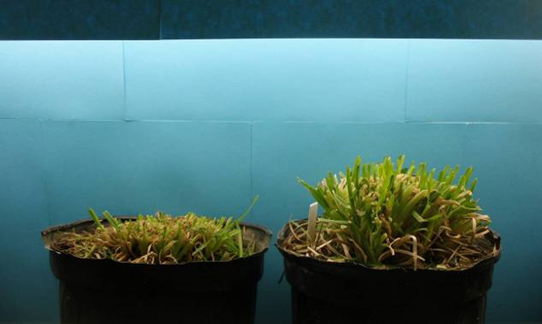

Day 1
(24 hours after clipping)
1” Continuous 3.5” Rotational

Slide 19
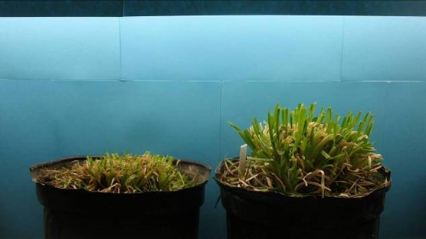
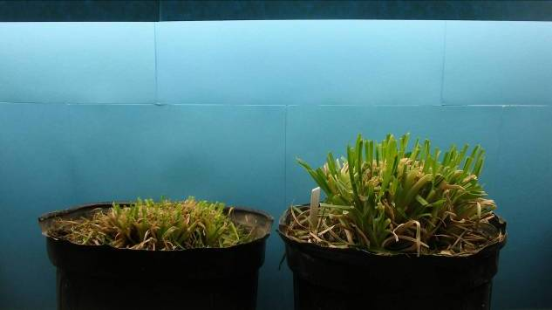
Day 2
1” Continuous 3.5” Rotational

Slide 20
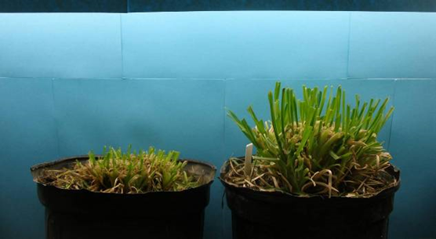
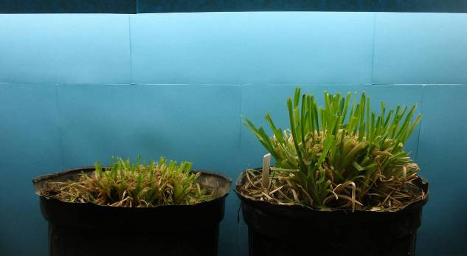
Day 3
1” Continuous 3.5” Rotational

Slide 21
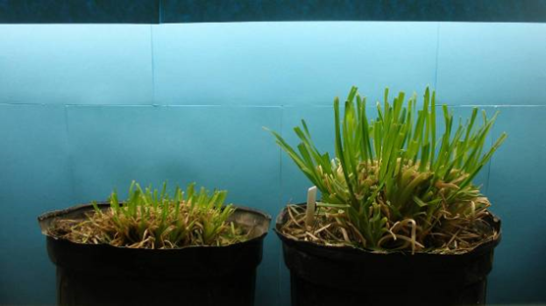

Day 4
1” Continuous 3.5” Rotational

Slide 22
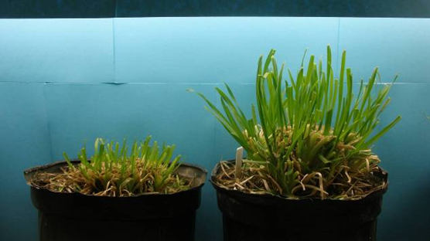

Day 5
1” Continuous 3.5” Rotational

Slide 23
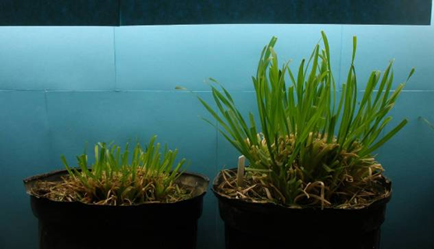

Day 6
1” Continuous 3.5” Rotational

Slide 24
Effect of post-grazing residual on pasture daily growth rate (MU-FSRC)
Time to grow 1 ton = 64 days
Time to grow 1 ton = 40 days
Time to grow 1 ton = 64 days
Time to grow 1 ton = 40 days
Time to grow 1 ton = 40 days
It takes grass to grow grass !
Notes:
It takes about 50% longer to grow a ton of feed if the pasture is grazed down to 2” compared to 4”.

Slide 25
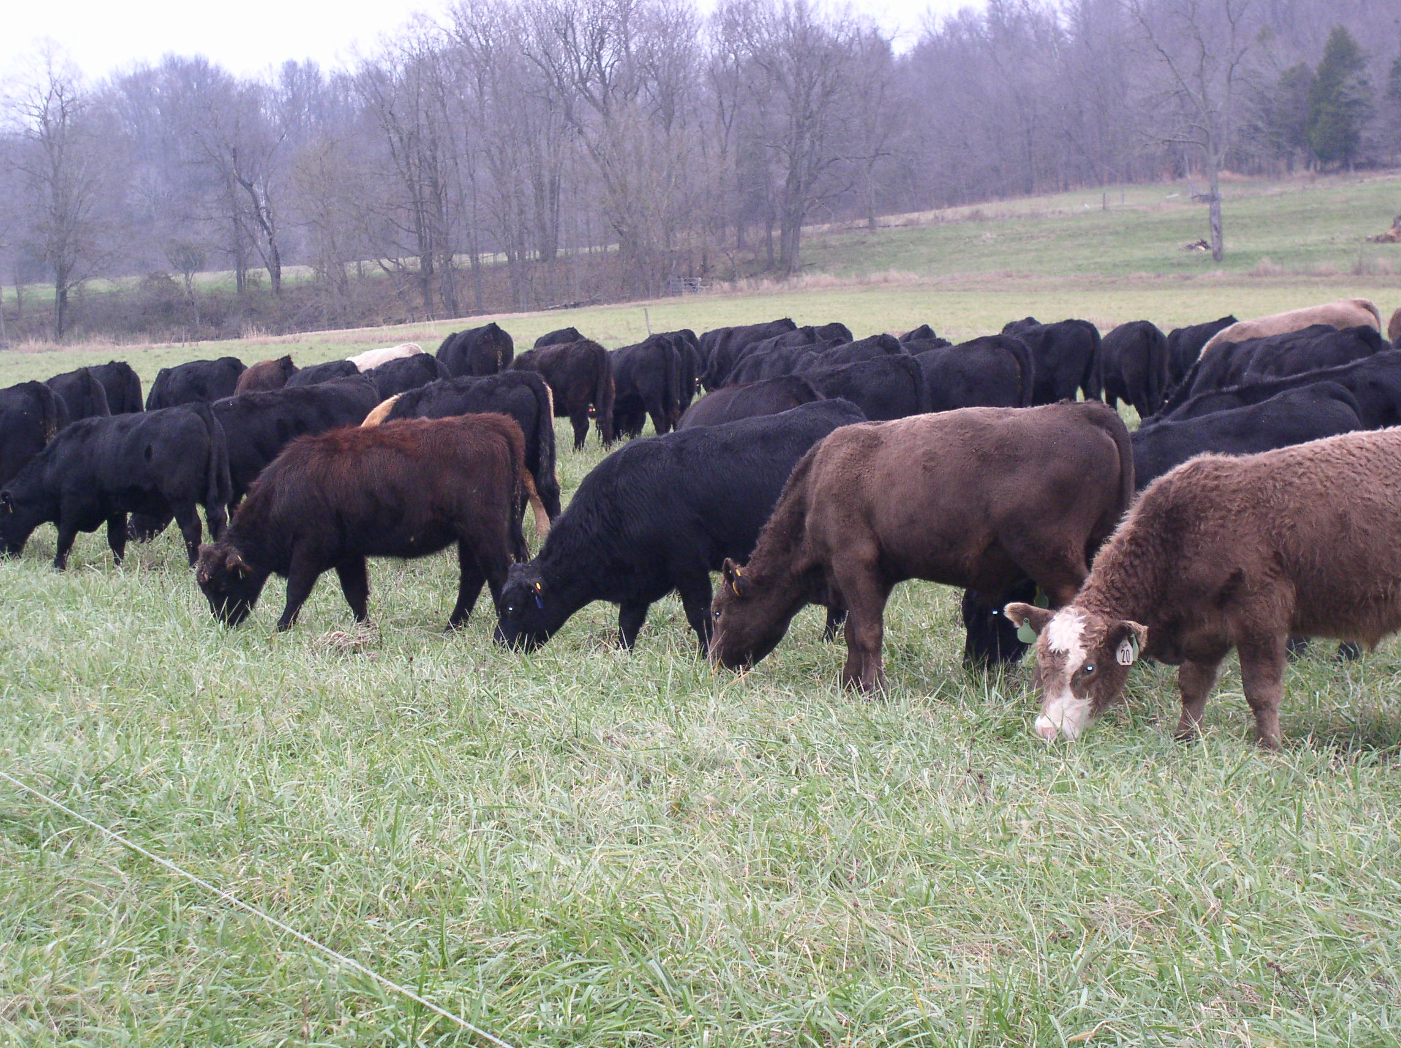
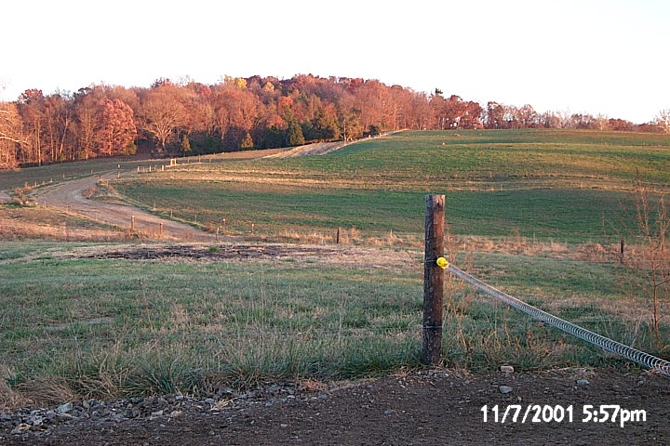
Adaptive Grazing
Forward Grazing
Creep Grazing
Prescribed Grazing
Managed Grazing
Rotational Grazing
Rotate prior to impacting most limiting resource
Rotate when next paddock is proper height to graze
Rotate when the paddock is soiled
Don’t limit yourself or your operation by locking into one form of management
Take half leave half
Mob Grazing
Ultra high stock density grazing
Landscaping
Flash Grazing
Seasonal Grazing
Put and Take
Strip Grazing
Time Limit Grazing
Adaptive Management Grazing
High density, short duration
Top third grazing

Slide 26
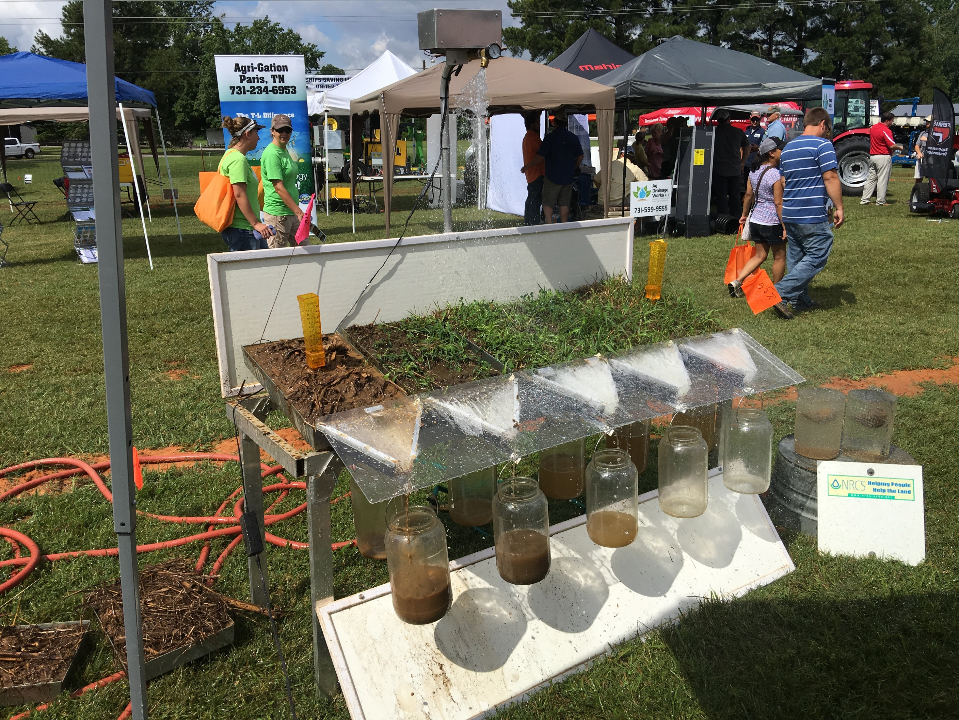
.
Cover: 0 30% 50% 70% 100%

Slide 27
Manure Distribution
Rotation Frequency | Years to Get 1 Pile/sq. yard
Continuous | 27
14 day | 8
4 day | 4 – 5
2 day | 2
1 day | ??
Twice/day | ???
Notes:
As part of the MU study, they estimated how long portions of the field might go without receiving manure. In continuous grazing, parts of the pasture will only receive manure from the cattle every 27 years. In other words portions of the pasture only receive fertilizer every 27 years. Intensive grazing can reduce this to every 2 years
There is no data for more than once per day

Slide 28
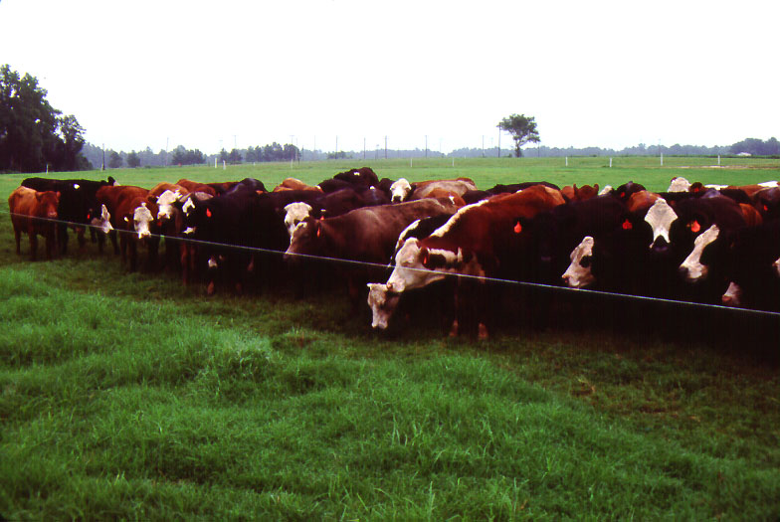
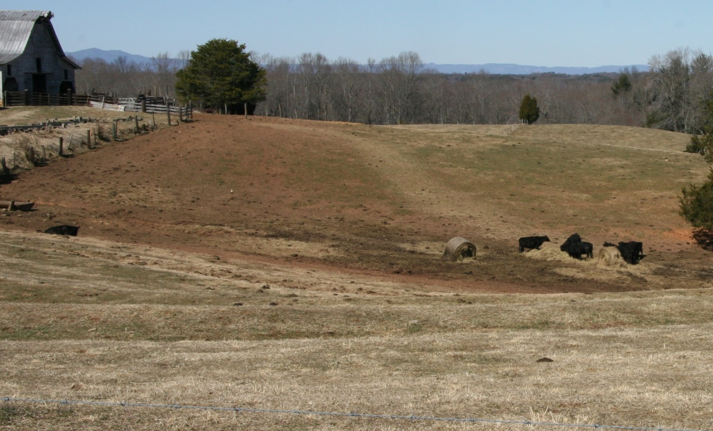
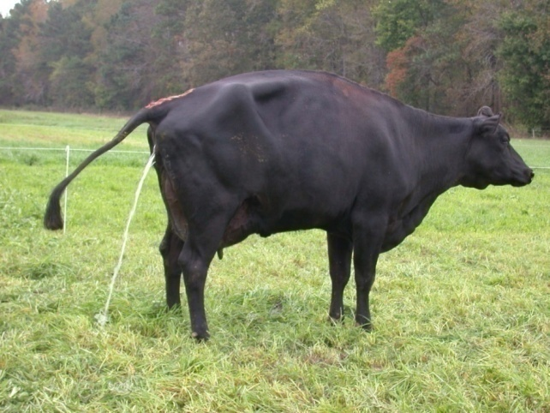
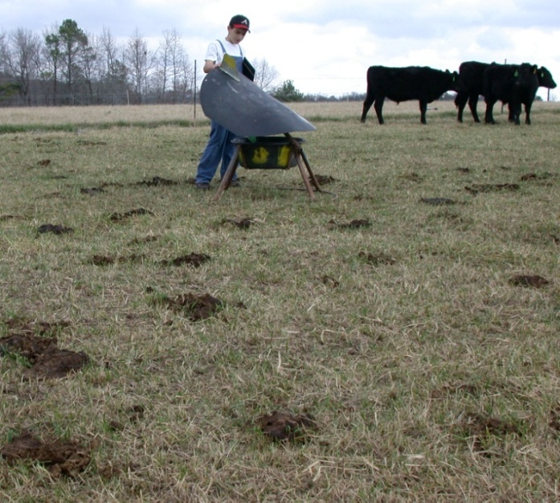
Impact of Manure and Urine recycling
90% N,P,K eaten is
returned to soil
~75% of N and K in Urine
~75% of P in Manure
Manure

Slide 29
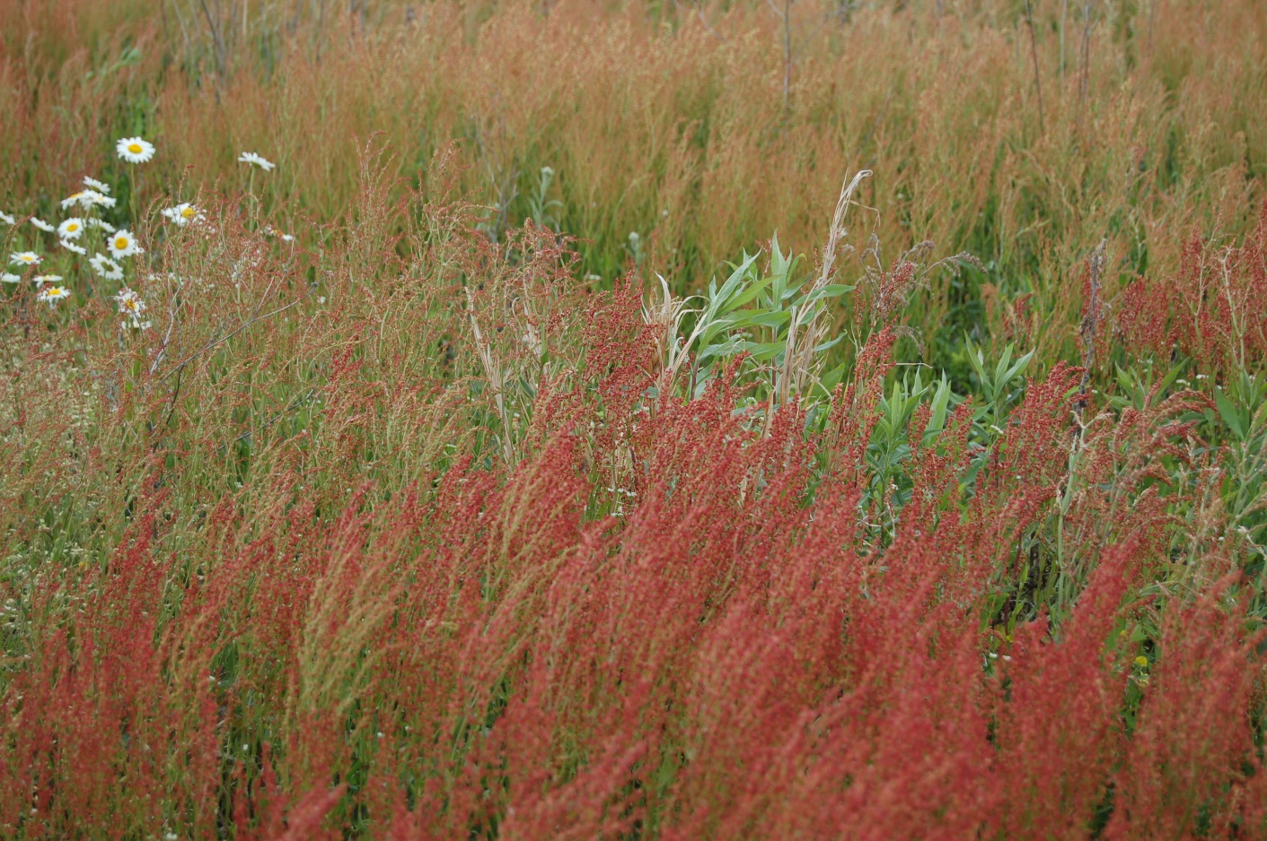
Indicator Plants, low fertility gregbrann.com
Species
Rabbit tobacco
Red sorrel
Poor joe
Broomsedge
Oxeye daisy
Sweet vernal grass?
Yarrow?
Low fertility soil

Slide 30
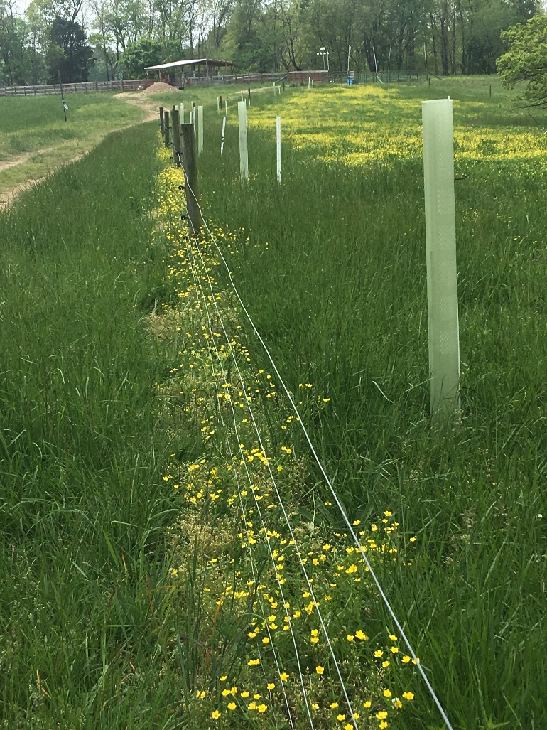
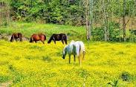
Reading the Land:
Indicator Plants, compaction, lack of cover
Species
Knotweed
Rushes
Goosegrass
Bitter sneezeweed
Dog fennel
Buttercup
Curly dock

Slide 31
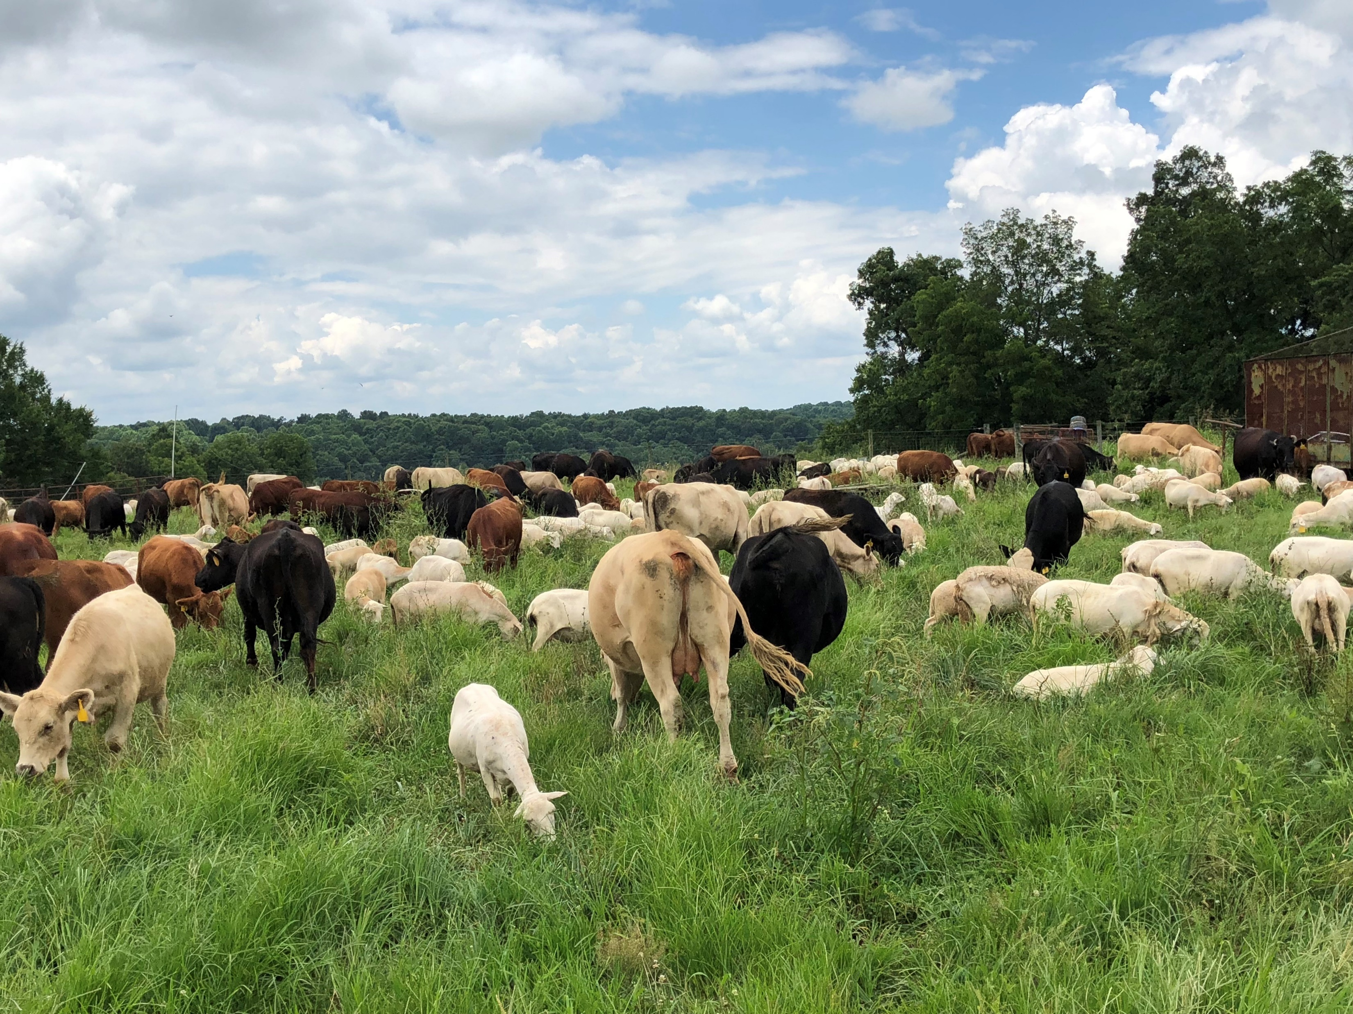
Grazing Strategies
Maintain carbohydrate reserves for regrowth and root development
Top third grazing, leaving the bottom two thirds maintains more plant cover
Balancing forage availability with stocking rate (Carrying Capacity) is critical
Rotate livestock prior to a rain event or confine them to a designated area when soils are prone to compaction
High Density grazing especially in long narrow paddocks will put more plant matter in touch with the ground
Notes:
Grazing and Hay Feeding Strategies - significantly influence plant cover, soil residue, diversity, compaction, roots, soil color, and life. Proper plant community management is the best strategy for maintaining the benefits of the soil food web. Plant production and the supply of organic matter can be maintained or enhanced by timely grazing, the proper frequency of grazing, and control of the amount of vegetation removed and residue maintained. Balancing forage availability with stocking rate (Carrying Capacity) is critical in improving soil organism habitat. Grazing is a disturbance, but it's best to minimize disturbance by practicing short-duration grazing. Perennial plants benefit from a periodic reset while maintaining carbohydrate reserves for regrowth.
In an overgrazed plant community, reducing surface plant material, residue, and roots will produce less food for soil organisms. As biological activity decreases, a downward spiral of the critical functions of soil organisms results in a lower organic matter content. Overgrazing impedes nutrient cycling, water infiltration, and storage, creating stress on the soil, plant, animals, and human resources.
Soil and plant communities not managed for soil habitat can be improved by longer recovery times, leaving significant residual plant matter and balancing soil nutrients. Plant diversity, including legumes, is significant in initiating soil health. Organic sources of nutrients are preferred; however, inorganic nutrients, when needed, are better than not applying them. Other alternatives to address nutrient imbalances are unrolling hay and high-density, short-duration grazing. Unrolling hay lowers the impact on the soil by spreading the cattle out, reducing mud while improving manure (nutrient) and residue (litter) distribution. Bale Grazing is another feeding option realizing that pasture renovation with seed will likely be needed after bale grazing. Feeding hay in a new location every feeding is a good practice to distribute urine and manure.
Plant communities with a dense canopy of vegetation maintained will have increased moisture and more stable soil temperature resulting in increased soil biota habitat, less residue, and decreased plant diversity. Less residue is due to soil life-consuming residue and faster decomposition rate. A full canopy of plants shades out other plants, decreasing diversity.
Epigenetics is a how we can change genetic expression through management.
Picture is high density (300,000 lb./ac) grazing multi-species of cattle and sheep.

Slide 32
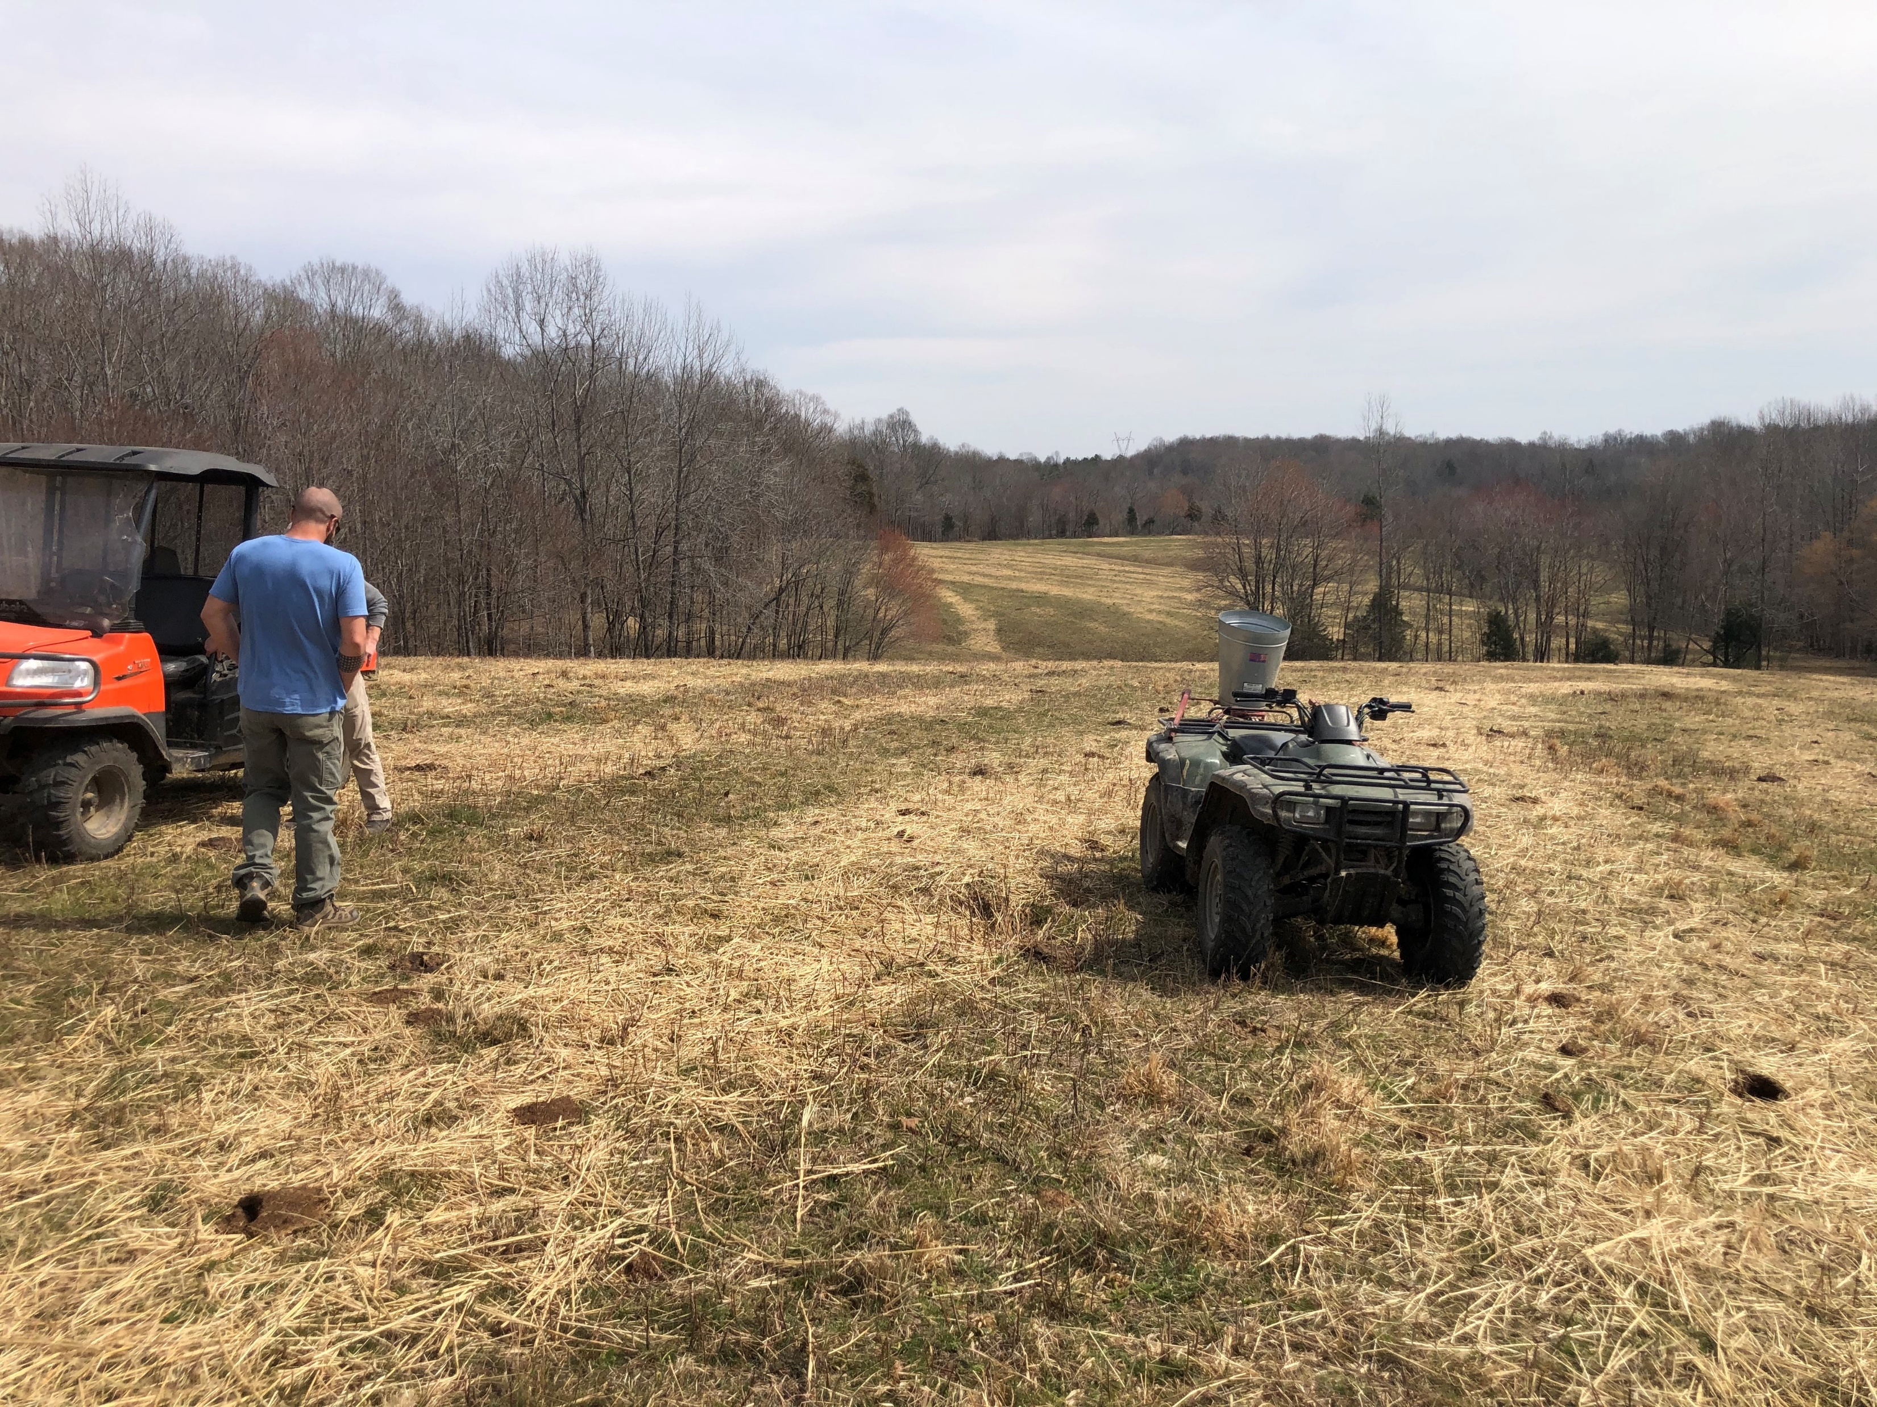
Hay Feeding Strategies
Unrolling hay lowers impacts on the soil, beware of tractor track damage in wet times with reduced cover. Some producers unroll hay with all-terrain or utility vehicles or track-driven equipment to reduce compaction issues
Bale grazing can also reduce impacts on the soil especially when bales are set out in a dry time and rationed with temporary fence
Feeding hay in a new location each feeding improves nutrient distribution
Forage yields can be increased by feeding hay on pasture (Teague TAMU)
  2-fold during late spring droughts
  1.5-fold in wet years
Notes:
Picture is where hay has been unrolled feeding cattle overwinter.

Slide 33
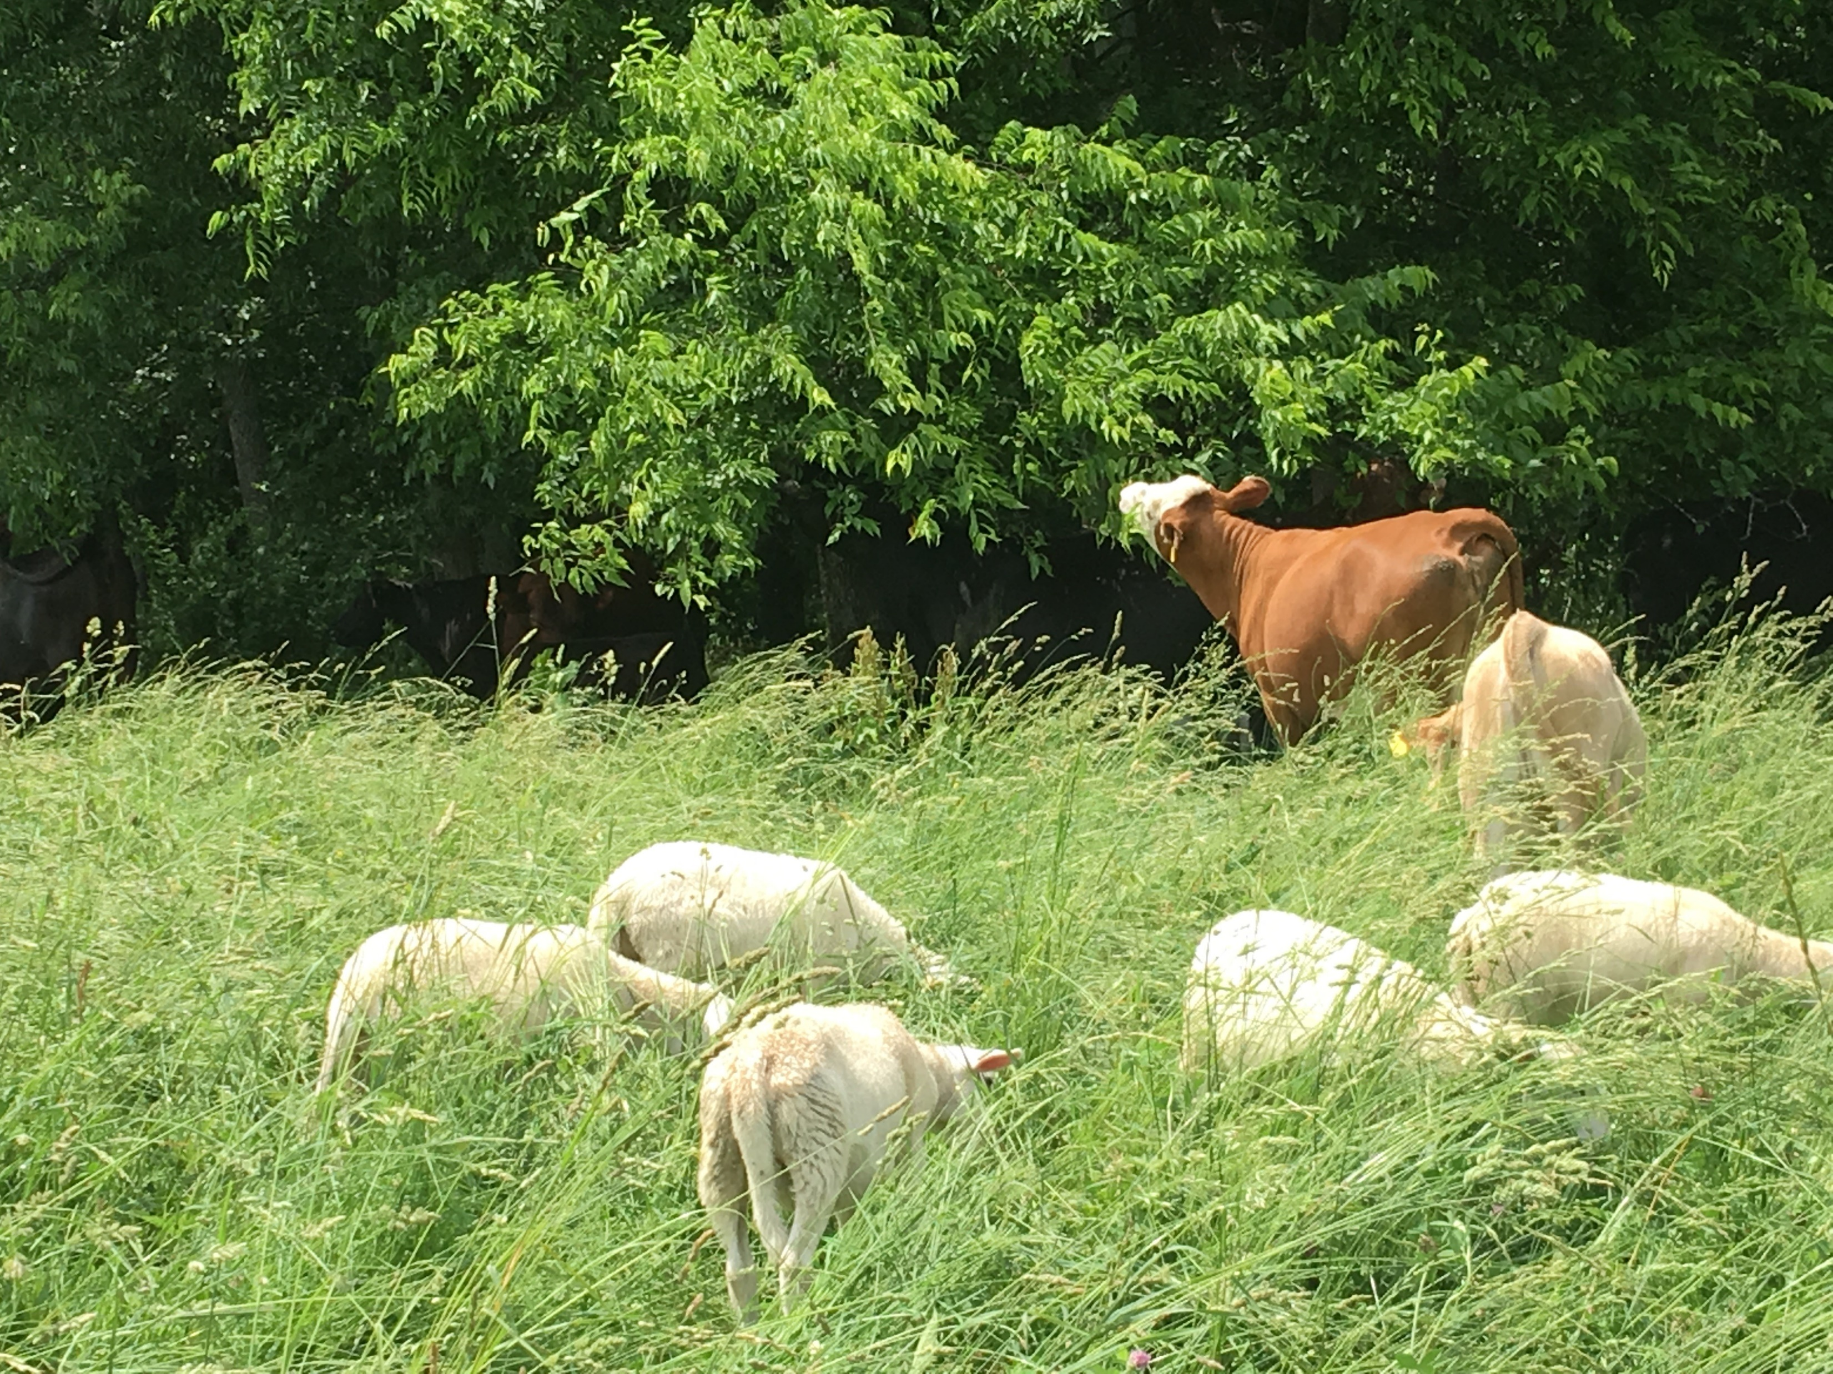
Livestock Management
Use fly control with less effect on dung beetles and other dung feeding insects and organisms
Co-grazing livestock such as sheep and goat with cattle
  Convert “weeds” to marketable animal products
  Pellet type manure has a positive effect on the pasture ecosystem.
Notes:
Picture is mature tall fescue and orchardgrass with sheep and cattle. Note cow is browsing tree leaves which are typically high quality and have more flavonoid compounds.

Slide 34
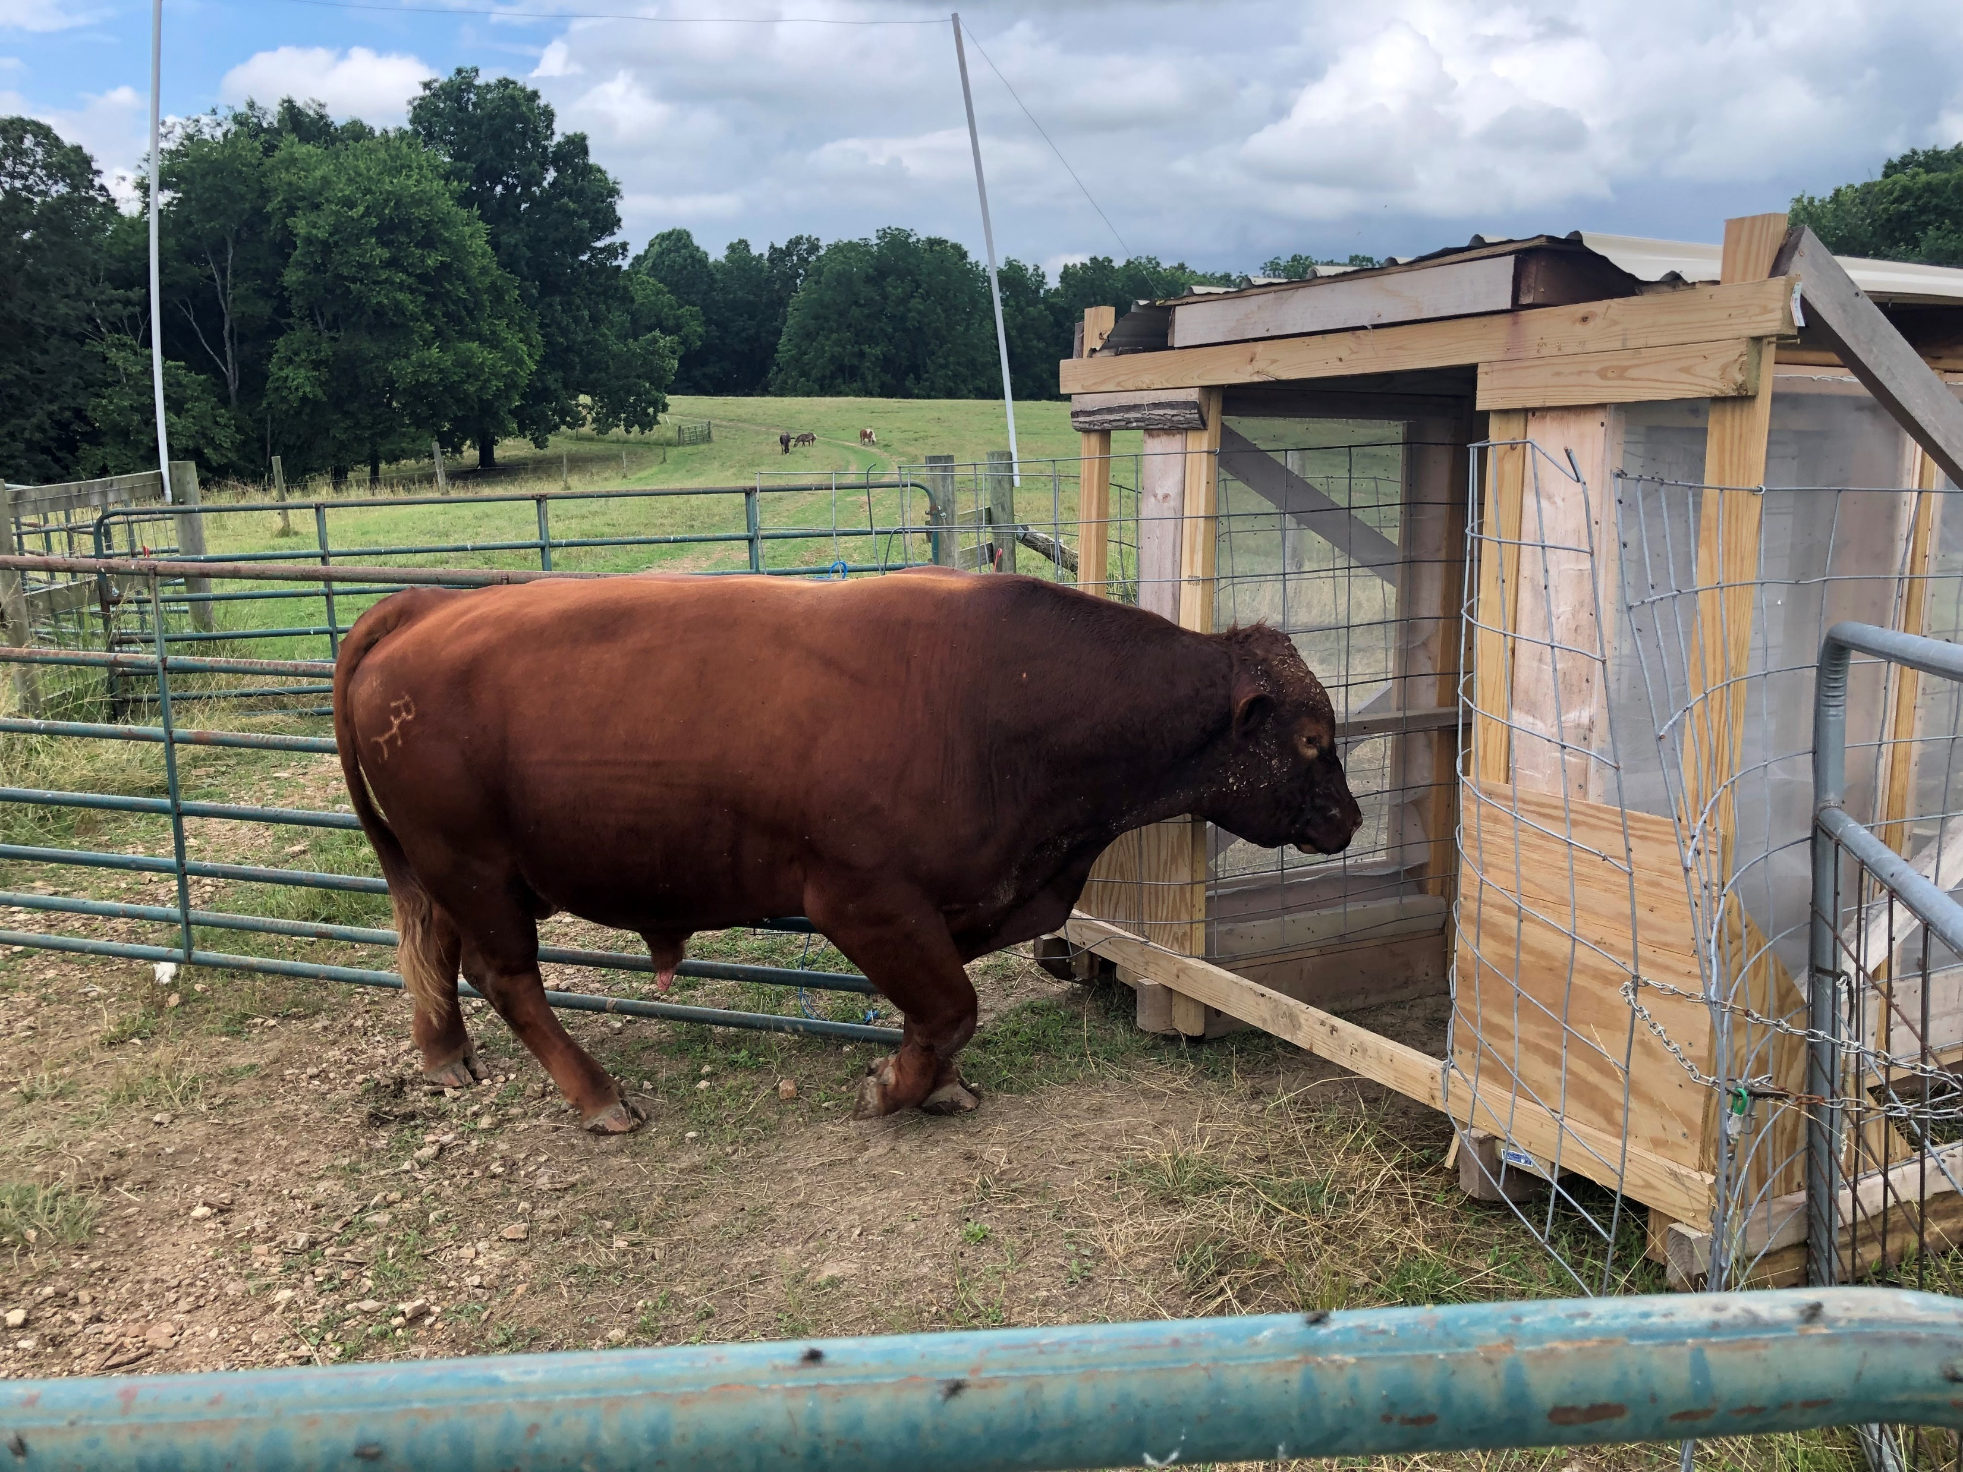
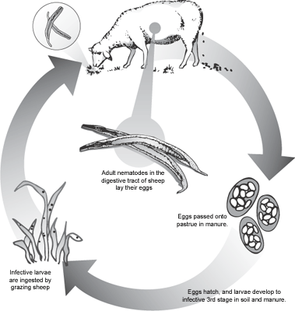

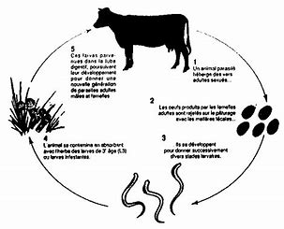
Safe Pasture- Soil Life Friendly
Grazed above 5”
Grazed with other stock for one season
14 days from ingestion before Haemonchus contortus sheds infected eggs.. For Ostertagia and Trichostrongylus it’s 21 days.
Most infective larvae in the bottom 5” of grass
5 days to months before larvae become infective dependent on moisture and warmth
Notes:
Pictured in the right hand corner is a red angus bull entering a walk through fly trap. The fly trap is designed like a minnow trap flies get trapped between two screens. Research shows that it keeps flies at an economic threshold which is 200 flies per animal. Designs are available on line from the University of Missouri.
The cycles of internal parasites shows that for sheep the worm cycle of haemaonchus contortus (barberpole worm) from ingestion to shed of infected eggs is 14 days. For cattle the cycle is 21 days. In both cattle and sheep the eggs are shed develop into larvae and travel up wet grass and are most abundant in grass shorter than five inches. So it the grazing height is above 5” less internal parasites are ingested.

Slide 35
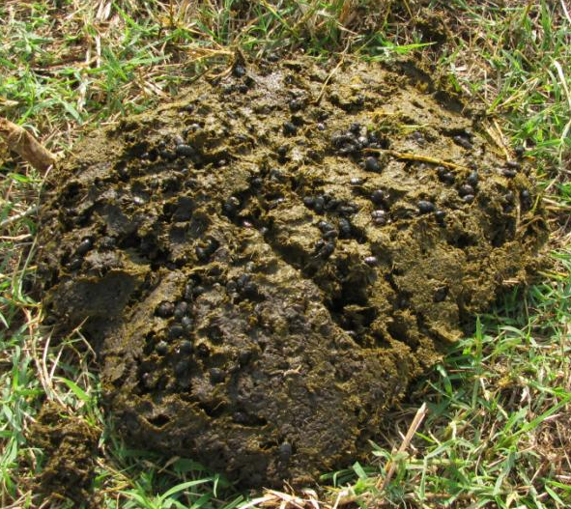
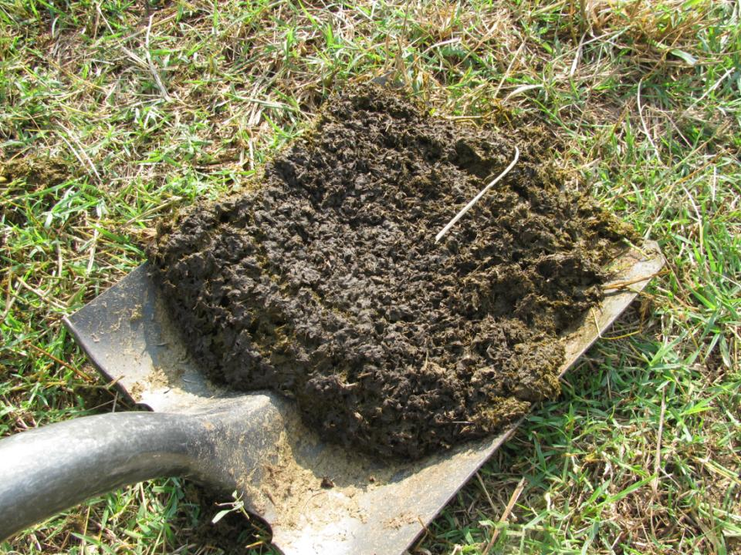
Dung Beetles
Notes:
Dung beetles can move and bury organic matter. Natural tillers in perennial systems. They can persist in grazing systems but thrive better where internal pesticides are absent.

Slide 36
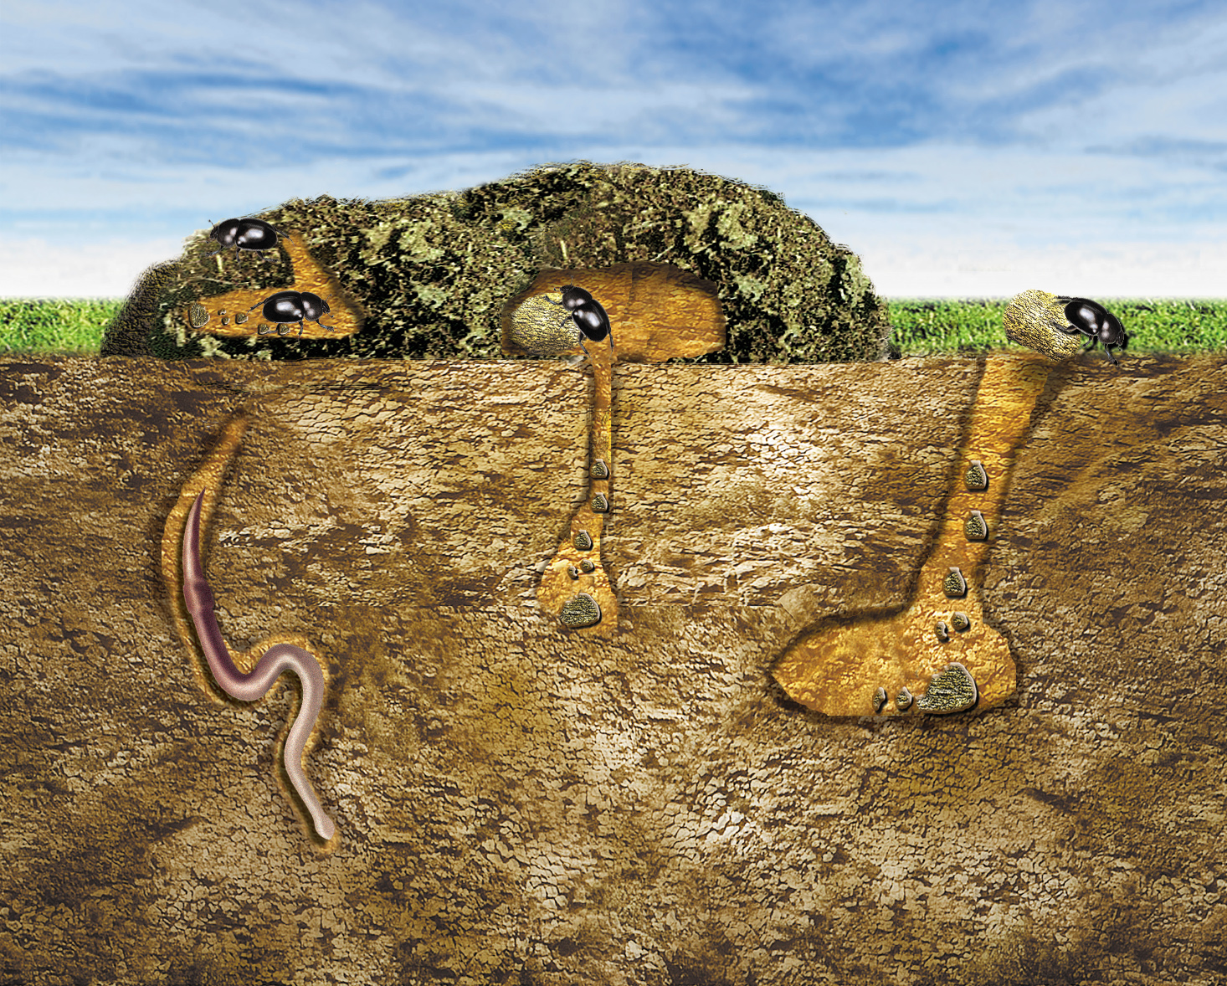
Types of Dung Beetles
Manure Dwellers
Tunnelers
Tumblers
Notes:
There are three basic kinds. Those that live in the manure, those that move manure directly down and the well know tumblers.

Slide 37
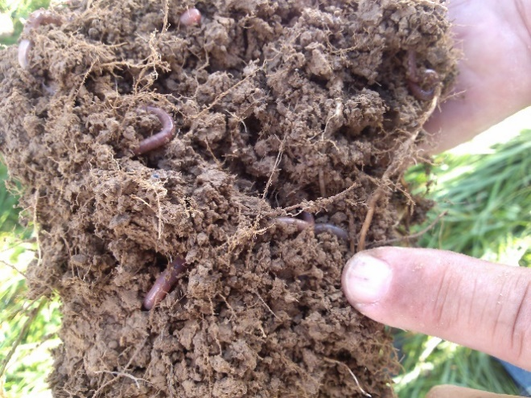
Biological:
Biomass of organisms above ground in the pasture and below ground within the pasture soil.
Organisms Standing crop biomass lbs/ac
Example:
Above ground
  1200 Dairy cow¹ or 518
  1200 Beef cow² 450
  Pasture³ 2500
  Total 3,018
Below ground
  Pasture roots⁴ 2500
  Bacteria 2052
  Actinomycetes 2052
  Fungi 6244
  Algae 219
  Protozoa 80
  Nematodes 62
  Mites 65
  Collembola 65
  Earthworms 624
  Other fauna 40
  Total 14,003
Adapted in part from Brady and Weil 2002.
1. Cow producing 40 lbs milk/day 180 days/acre, 50% of forage
standing crop consumed, 5 rotations/year.
2. Cow weaning 600 lb calf 3 acres/year.
3. Cool-season grass-clover pasture, 10 inches tall at grazing.
4. Roots equal top growth at grazing.
(518 avg wt @2.67 ac/cow)

Slide 38
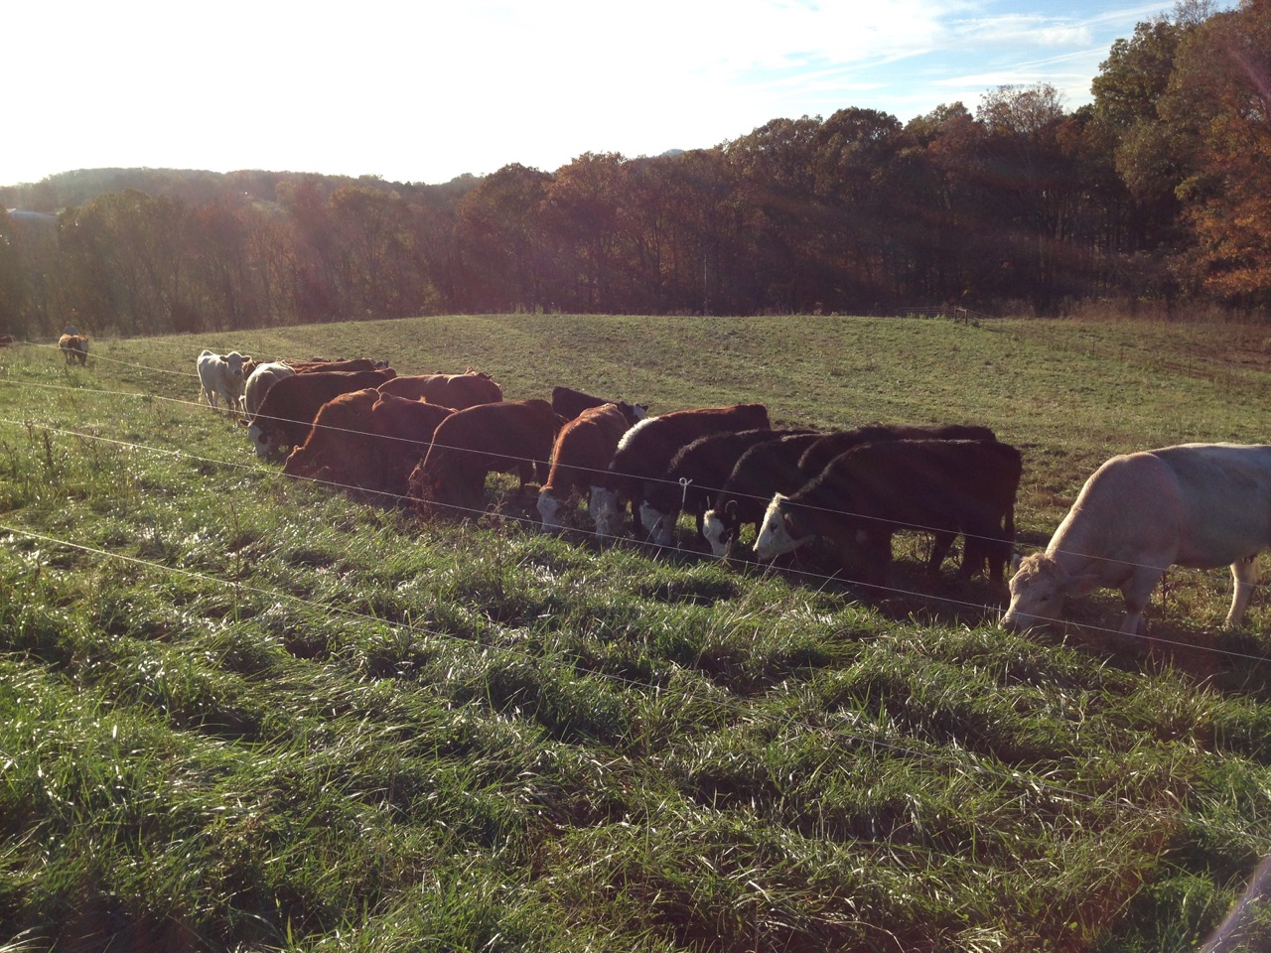
Maximum Stocking Rate with on farm Forage-
Forage Animal Balance with Top Management
Animal Demand
365 days x
26 lb/day/
9490/2,000 ~ 5 ton/yr
Forage Production
3 ton/ac/yr
80 acres (avg pasture acres)
240 ton production
70 percent down throat (1-2 day rotation)
168 tons/5 ton/AU = 34
2.35 ac/AU
Every additional AU needs 5 ton of hay per year
Note: typical manager is yielding 2 ton/ac and grazing efficiency is less than 50% down the throat so need 5 ac/AU
Notes:
Carrying capacity is when stocking rate is appropriately matched with forage production. This example show one 1,000 pound cow (1 Animal Unit, AU) consumes approximately 26 pounds of forage per day which is equal to 5 tons per year. This example shows that if production is 3 tons/ac/yr and 70% of forage is consumed the stocking rate would be 2.35 ac/AU whether the forage is grazed or harvested as hay. This is a very high utilization rate a more reasonable rate is 50% considering this the carrying capacity would be 3.33 ac/AU. Now if the yield is only 2 tons/ac/yr and the utilization rate is 2 tons the carrying capacity would be 5 ac/AU.

Slide 39
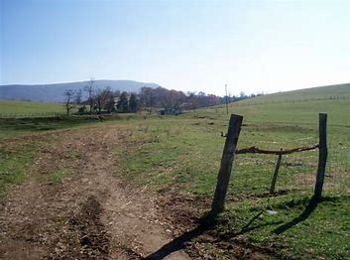
INDICATORS OF OVERSTOCKING
Grass seldom over 3” tall
Frequent need to spray weeds
Loss of stand in drought
Bare ground, trailing etc.
Increased ponding and runoff
Desirable forages limited to those that tolerate low grazing
Undesirable plant community
Feeding hay more than 100 days
Low body condition
Lack of rumen fill

Slide 40
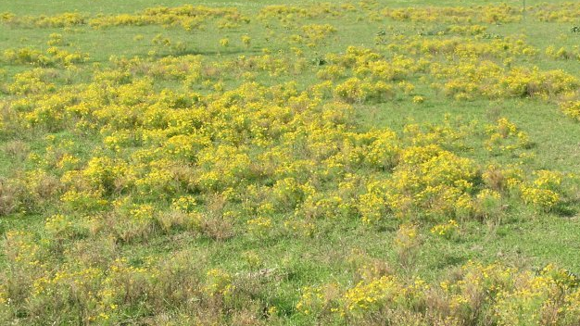
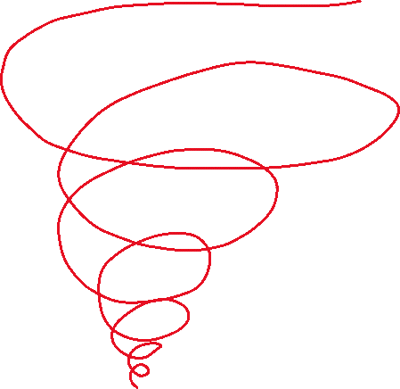
Consequences of Overgrazing
“It’s a downward spiral”
Lower production
Slower regrowth
Reduced longevity
Reduced root mass
Increased weeds
Reduced water infiltration
Increased water evaporation
Increased soil temperature
Diminished soil habitat
Reduced soil function
Undesirable plant community
Increased need for hay
Notes:
Have students identify all of the impacts on the soil that overgrazing leads too, don’t simply focus on the plant

Slide 41
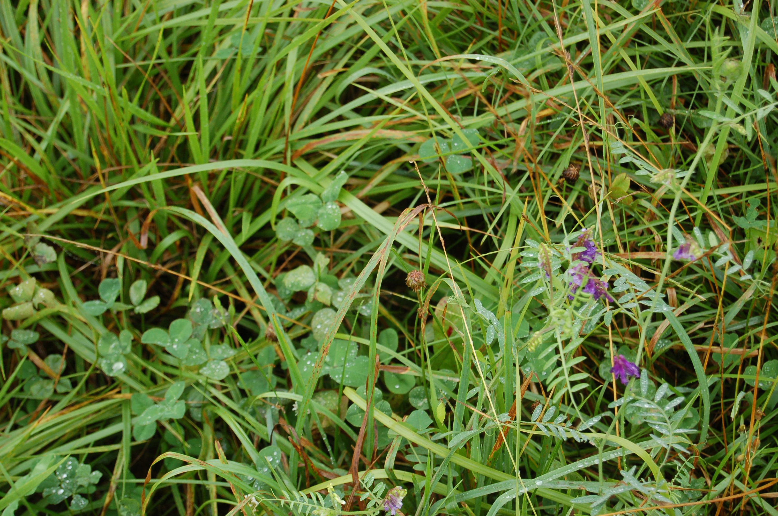
Quote:
“Do everything possible to avoid bare ground!”
Raymond Cooper

Slide 42
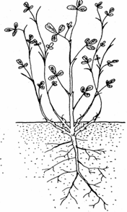
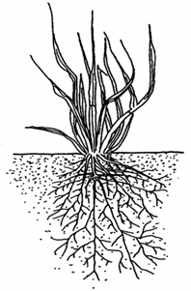
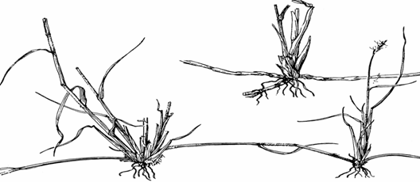
Grasses & Legumes
Understanding plant parts
Fibrous Root System
Root System
  Legume: tap
  Grass: fibrous
Rhizome
  stem below surface
  stores CHO
  spreading
Stolon
  stem above soil
  stores CHO
  spreading
Tap Root System
Rhizome
Soil Surface
Stolon

Slide 43
Understanding Plant Growth!
Sun
95% raw material..air
N
CO2
Water
Implications for Grazing/Harvesting Management on any farm

Slide 44
Photosynthesis Process
CO₂
Sun
Energy
O₂
Glucose
Protein
Fiber
Lignin
Minerals &
Water
Fats
Other sugars
Organic compounds

Slide 45
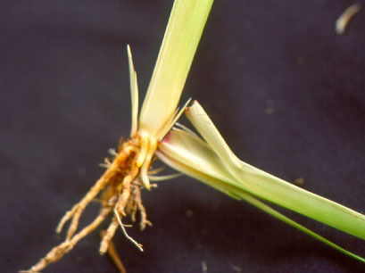
Roots
Region of cell division &growth
Tall Fescue plant
Storage organ;
lower 3” of stem
Next generation plant (tiller)
Old leaf sheath pulled away from stem base

Slide 46
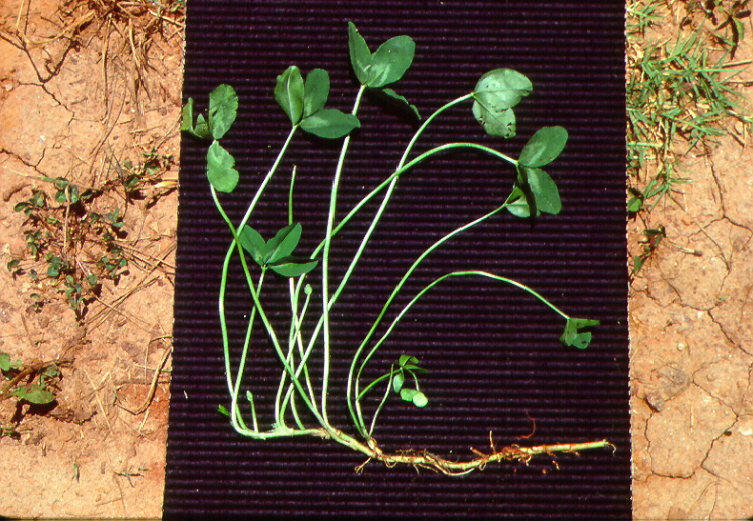
Ladino Clover
growing point
stolon

Slide 47
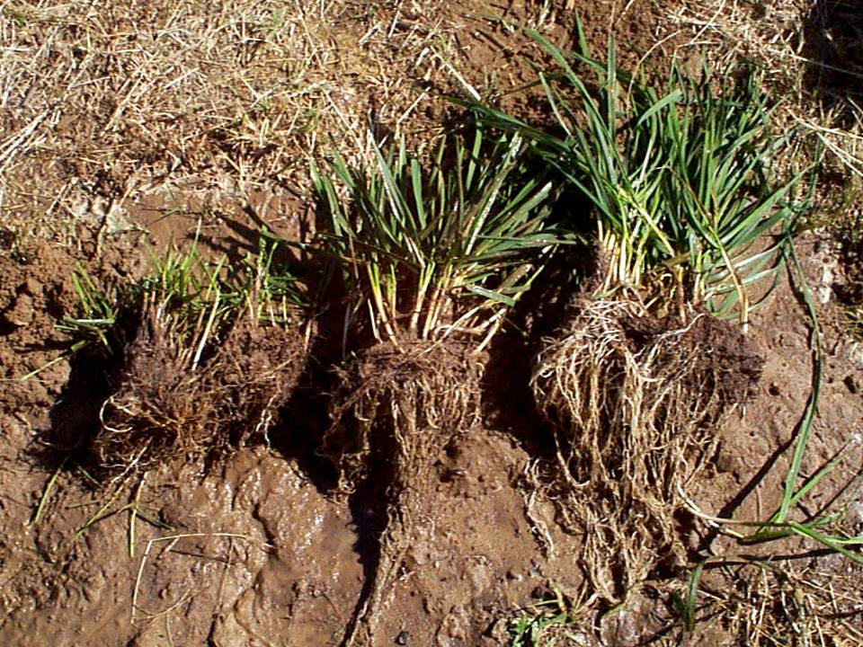
Root development is strongly related to frequency and extent of leaf removal
Cut to 2”
every week
Cut to 2”
every 4 weeks

Slide 48
Impacts of Grazing
Grasslands for Soil Health
% Leaf Removed
% Root Growth Stopped
10
0
20
0
30
0
40
0
50
2 to 4
60
50
70
78
80
100
90
100
Notes:
The results shown above are from Rhodes grass (Chloris gayana) which is a tropical grass native to Africa. Crider also looked at Kentucky Bluegrass and Smooth Brome. Smooth Brome for instance had a slightly lower tolerance to defoliation than Rhodes grass where somewhere between 40 and 50% stopped root growth of many of the plants roots. It might be best to modify this table to show a cool-season plant’s response for trainings in northerly latitudes instead of using a tropical grass.
Source: Crider, Franklin J. 1955. Root-Growth Stoppage from Defoliation of Grass. Technical Bulletin No. 1102. United States Department of Agriculture Soil Conservation Service.

Slide 49
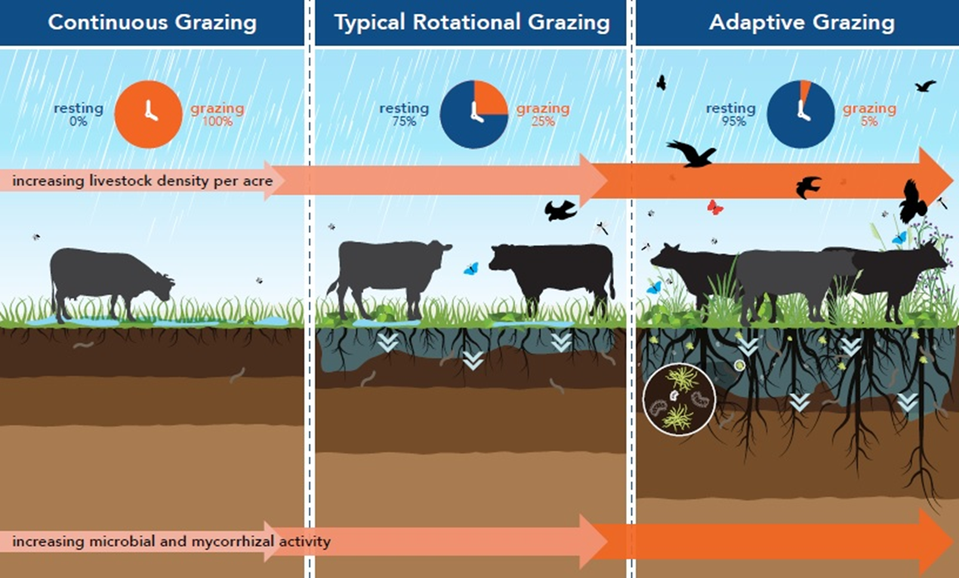

Effect of Recovery Period
20-paddock system
4-paddock system
High Intensity, Low Frequency Grazing
Modified from the Pasture Project
Notes:
Adaptive grazing management draws upon various different grazing systems based on feedback from the system as well as labor constraints. There will be times when management can be less intensive where a good rotational grazing system can still be beneficial provided it minimizes/prevents overgrazing. The typical rotational grazing system in the middle part of this graphic is merely a four paddock per herd setup. While this is an improvement versus the continuous grazing happening on the left side of the graphic, quite a bit of overgrazing is still happening. At other times of the year adaptive grazing management can be much more intensive like with the 20-paddock example using a High Intensity, Low Frequency (HILF) grazing system. This grazing system concentrates livestock in a very small area for just a day (or less) at a time. Notice that the plants in the HILF grazing system are taller and more mature while the roots are deeper to show that this type of grazing management emphasizes greater plant recovery to feed soil life and improve soil health. Also notice that as the roots are growing deeper, water is penetrating deeper into the soil. With deepening roots and soil moisture, soil life also increases which facilitates the deepening of the topsoil as shown by the darker soil colors going deeper. Because the HILF grazing system requires a very high level of management, it is usually implemented for just three to four months.
Graphic modified from: Grazing Cover Crops: A How-To Guide from the Pasture Project, 2019, pg. 20
http://pastureproject.org/resources-2/articles-studies/grazing-cover-crops/
National Range and Pasture Handbook, USDA-NRCS

Slide 50

When You Overgraze the Shoot You Overgraze the Root!
Tall Fescue Tall Fescue Tall Fescue Orchardgrass Orchardgrass Fescue/Bluegrass
Rotational Continuous Continuous Rotational Rotational Rotational
Notes:
Photo source: Sid Brantley

Slide 51

Leaves – The Facts of Growth
Roots uptake and send water, minerals, and micronutrients to leaves.
Roots DO NOT transport carbohydrates to the leaves.
Leaves use carbohydrates to respire.
5-10% of new leaf growth is from residual sheath & crown carbohydrate reserves.
90-95% of new leaf growth comes from carbohydrates resulting from current photosynthesis.
Bottom line – it takes leaves to make leaves.
Notes:
Roots send water, minerals and micronutrients to the plant above ground (leaves) – with mycorrhizal fungi, the area they extract from can be 10 times greater (most native plants are mycorrhizal fungi obligates).
However, roots do not transport non-structural carbohydrates (the food that leaves need to respire) to the leaves.
All living things respire, including leaves, and typically use carbohydrates to do this.
For new growth after a grazing event or in the spring when growth initiates, 5-10% of this new growth comes from carbohydrate reserves in the upper part of the plant crown near the soil surface, from the grass sheaths (if they haven’t been grazed off), and more recently discovered storage areas in the grass nodes.
But 90-95% of new leaf growth comes from carbohydrates from current photosynthesis, what the new leaves are generating.
Bottom line, it takes leave to make leaves.

Slide 52
Effects of soil cover by a mixture of bluegrass & white clover & weeds on rainfall runoff from 1.4” rain/hr. (PA)
30%slope
21%slope
27%slope
1.13”
infiltration
Potential drought impact
0.28”
infiltration

Slide 53

Characteristics of Acute Disturbance Related to Grazing
Mimics natural disturbance patterns under changing environmental conditions
  Timing: variable → plants grazed at different times of year to facilitate pasture diversity
  Frequency: low → plants grazed few times per year for total plant recovery of desirable plants
Vermont Pasture Network
Notes:
[Picture can be replaced with a more local representation.]

Slide 54

Acute Disturbance (cont.)
  Intensity: high → most plants grazed light to moderately to enhance root biomass; high degree of trampling to protect soil surface, feed soil life; short grazing duration* to prevent re-grazing of desirable plants
*Depending on forage growth rate, resource concerns, time constraints, and objectives
Notes:
[Picture can be replaced with a more local representation.]

Slide 55


Forage Quality Declines as
Livestock Graze Closer to the Soil
Higher Forage Quality
CP: 14% TDN: 63.5% RFV: 149.1
50% by Weight
Lower Forage Quality
CP: 7.2% TDN: 56.3% RFV: 97.9
Marlon Winger, USDA-NRCS
Notes:
Whether grazing cover crops or perennial forages, the highest forage quality (energy and protein) is in the leaves that are the most photosynthetically active or nearest the sun. This is part of the reason why we don’t want livestock in a paddock too long, especially if high rates of gain are desired or if there is to be a second graze.
Forage quality data from the Menoken Farm in Burleigh County, ND (Jay Fuhrer) showed that on a nine-way species mix with cool and warm-season grasses, brassicas, and legumes, the top half of the mixture (by weight) had nearly twice as much crude protein, nearly 13% higher energy measured as Total Digestible Nutrients (TDN), and 52% greater Relative Feed Value (RFV).
How would these values differ if only the top one-third or one-fourth was grazed? They would be higher yet, enough to sustain very high rates of gain for performance livestock.

Slide 56
Summary (4)
Grow grass when you can!
Its ok to not keep everything vegetative! Cows don’t have to have the best nutrition year around.

Slide 57

Effect of Graze Period on
Animal Performance
University of Missouri Forage Systems Research Center
Notes:
This research shows that as livestock remain in the same spot for longer and longer periods of time, forage intake decreases steadily. As livestock eat less, weight gain also decreases. Livestock eat more and gain more weight when allowed access to fresh forage.
Source: Gerrish, J.R., Martz, F.A., Tate, V.G., Morrow, R.E., 1998. Length of the Grazing Period: Does it Really Matter. University of Missouri Forage Systems Research Center.

Slide 58
Summary (5)
Be Random
This is very important! Randomness equates to diversity not only in plants but in carbon amounts!

Slide 59
Dimensions of Disturbance
  Timing
  Frequency
  Intensity
Natural disturbance patterns that stimulate major ecological change generally exhibit:
Variable timing
Low frequency
High intensity
Intensity
Timing
Frequency
Notes:
Timing refers to “when” an event occurs. Frequency refers to “how often” the event occurs over a specified time period. Intensity refers to the energy released per unit area and time. Duration or “how long” an event lasts would be included in the intensity dimension since intensity includes the time factor.
Chapin, F.S., Matson, P.A., Vitousek, P.M., 2012. Principles of Terrestrial Ecosystem Ecology, Second Edition. Springer Science+Business Media. pgs. 348-350.

Slide 60





Portable Fencing Equipment
Doug Peterson, USDA-NRCS
Doug Peterson, USDA-NRCS
Gallagher
Powerflex Fence
Novel Ways, Ltd.
Notes:
[In some states, these may not be cost-sharable items – remove this slide and the next if desired/necessary, or add appropriate cost-sharable component photos.]
Upper left photo: portable mineral tubs on tires for towing with an ATV make moving mineral frequently very easy. Photo courtesy of Doug Peterson, Regional Soil Health Specialist for Iowa and Missouri.
Upper right photo: retrofitted ATV with portable step-in post rack makes building and taking down portable electric fence very quick and easy. Photo courtesy of Doug Peterson, Regional Soil Health Specialist for Iowa and Missouri.
Middle photo: Gallagher geared reel designed for holding 1,320 feet of polywire. One revolution on the crank spins the spool 3 times for fast retrieval of polywire. The unit pictured here costs between $67 and $80 without the wire.
Lower left photo: 1,320 feet of polybraid. Polybraid is a type of polywire that is weaved whereas most polywire is twisted. Compared to standard polywire, braided polywire usually has more wires embedded in it (up to 9) to maintain voltage over longer distances. Braided polywire is generally more expensive, but typically lasts a lot longer with fewer shorts making the braided product more of the choice for the professional grazier. The spool pictured here costs around $50 for 1,320 feet (1/4-mile).
Lower right photo: Batt-Latch Automatic Gate Timer. Although expensive (at least $400 each), these devices can be programmed to release a coil-spring gate at a preset day and time so that livestock can admit themselves into the next paddock without a human having to be there. There are producers who have up to seven of these set up all to go off every two hours throughout the day to achieve ultra-high stock densities.

Slide 61



Water: Portable Water Troughs
Rubbermaid
K-Line North America
Judge Jessop
Notes:
Left photo: Rubbermaid 50 gallon stock tank.
Right photo: K-Line mobile stock tank for pulling behind an ATV
Bottom photo: Above-ground pipe and quick-connect coupler for portable stock tank on cropland.

Slide 62
What our beef industry was built on
Cheap Land
Cheap Feed
Cheap Fuel
Cheap Fertilizer
Cheap Labor
Doing the same thing the same way and expecting a different result? Could what we are doing? Could be insanity!

Slide 63


Don’t be This Guy!

Slide 64
Summary (6)
If your organic matter
and aggregate stability
are increasing AND its
profitable, keep doing it!

Slide 65

Silvopasture
Select and plant adapted trees and forage that match the environmental conditions and livestock needs
Manage light to forage
  75% ideal
  50% minimum to cool season forage
  60% minimum to warm season forage
Protect trees from livestock
Practice rotational grazing management

Slide 66

Conduct Pasture Assessments
Pasture assessments identify areas needing attention
Plant Cover
Soil Residue
Living Roots
Aggregate Stability
And other indicators

Slide 67
Thank you!
For more information on Managing Soil Health,
visit us here:
https://www.nrcs.usda.gov/conservation-basics/natural-resource-concerns/soils/soil-health
USDA is an equal opportunity provider, employer, and lender.

